Slide 1
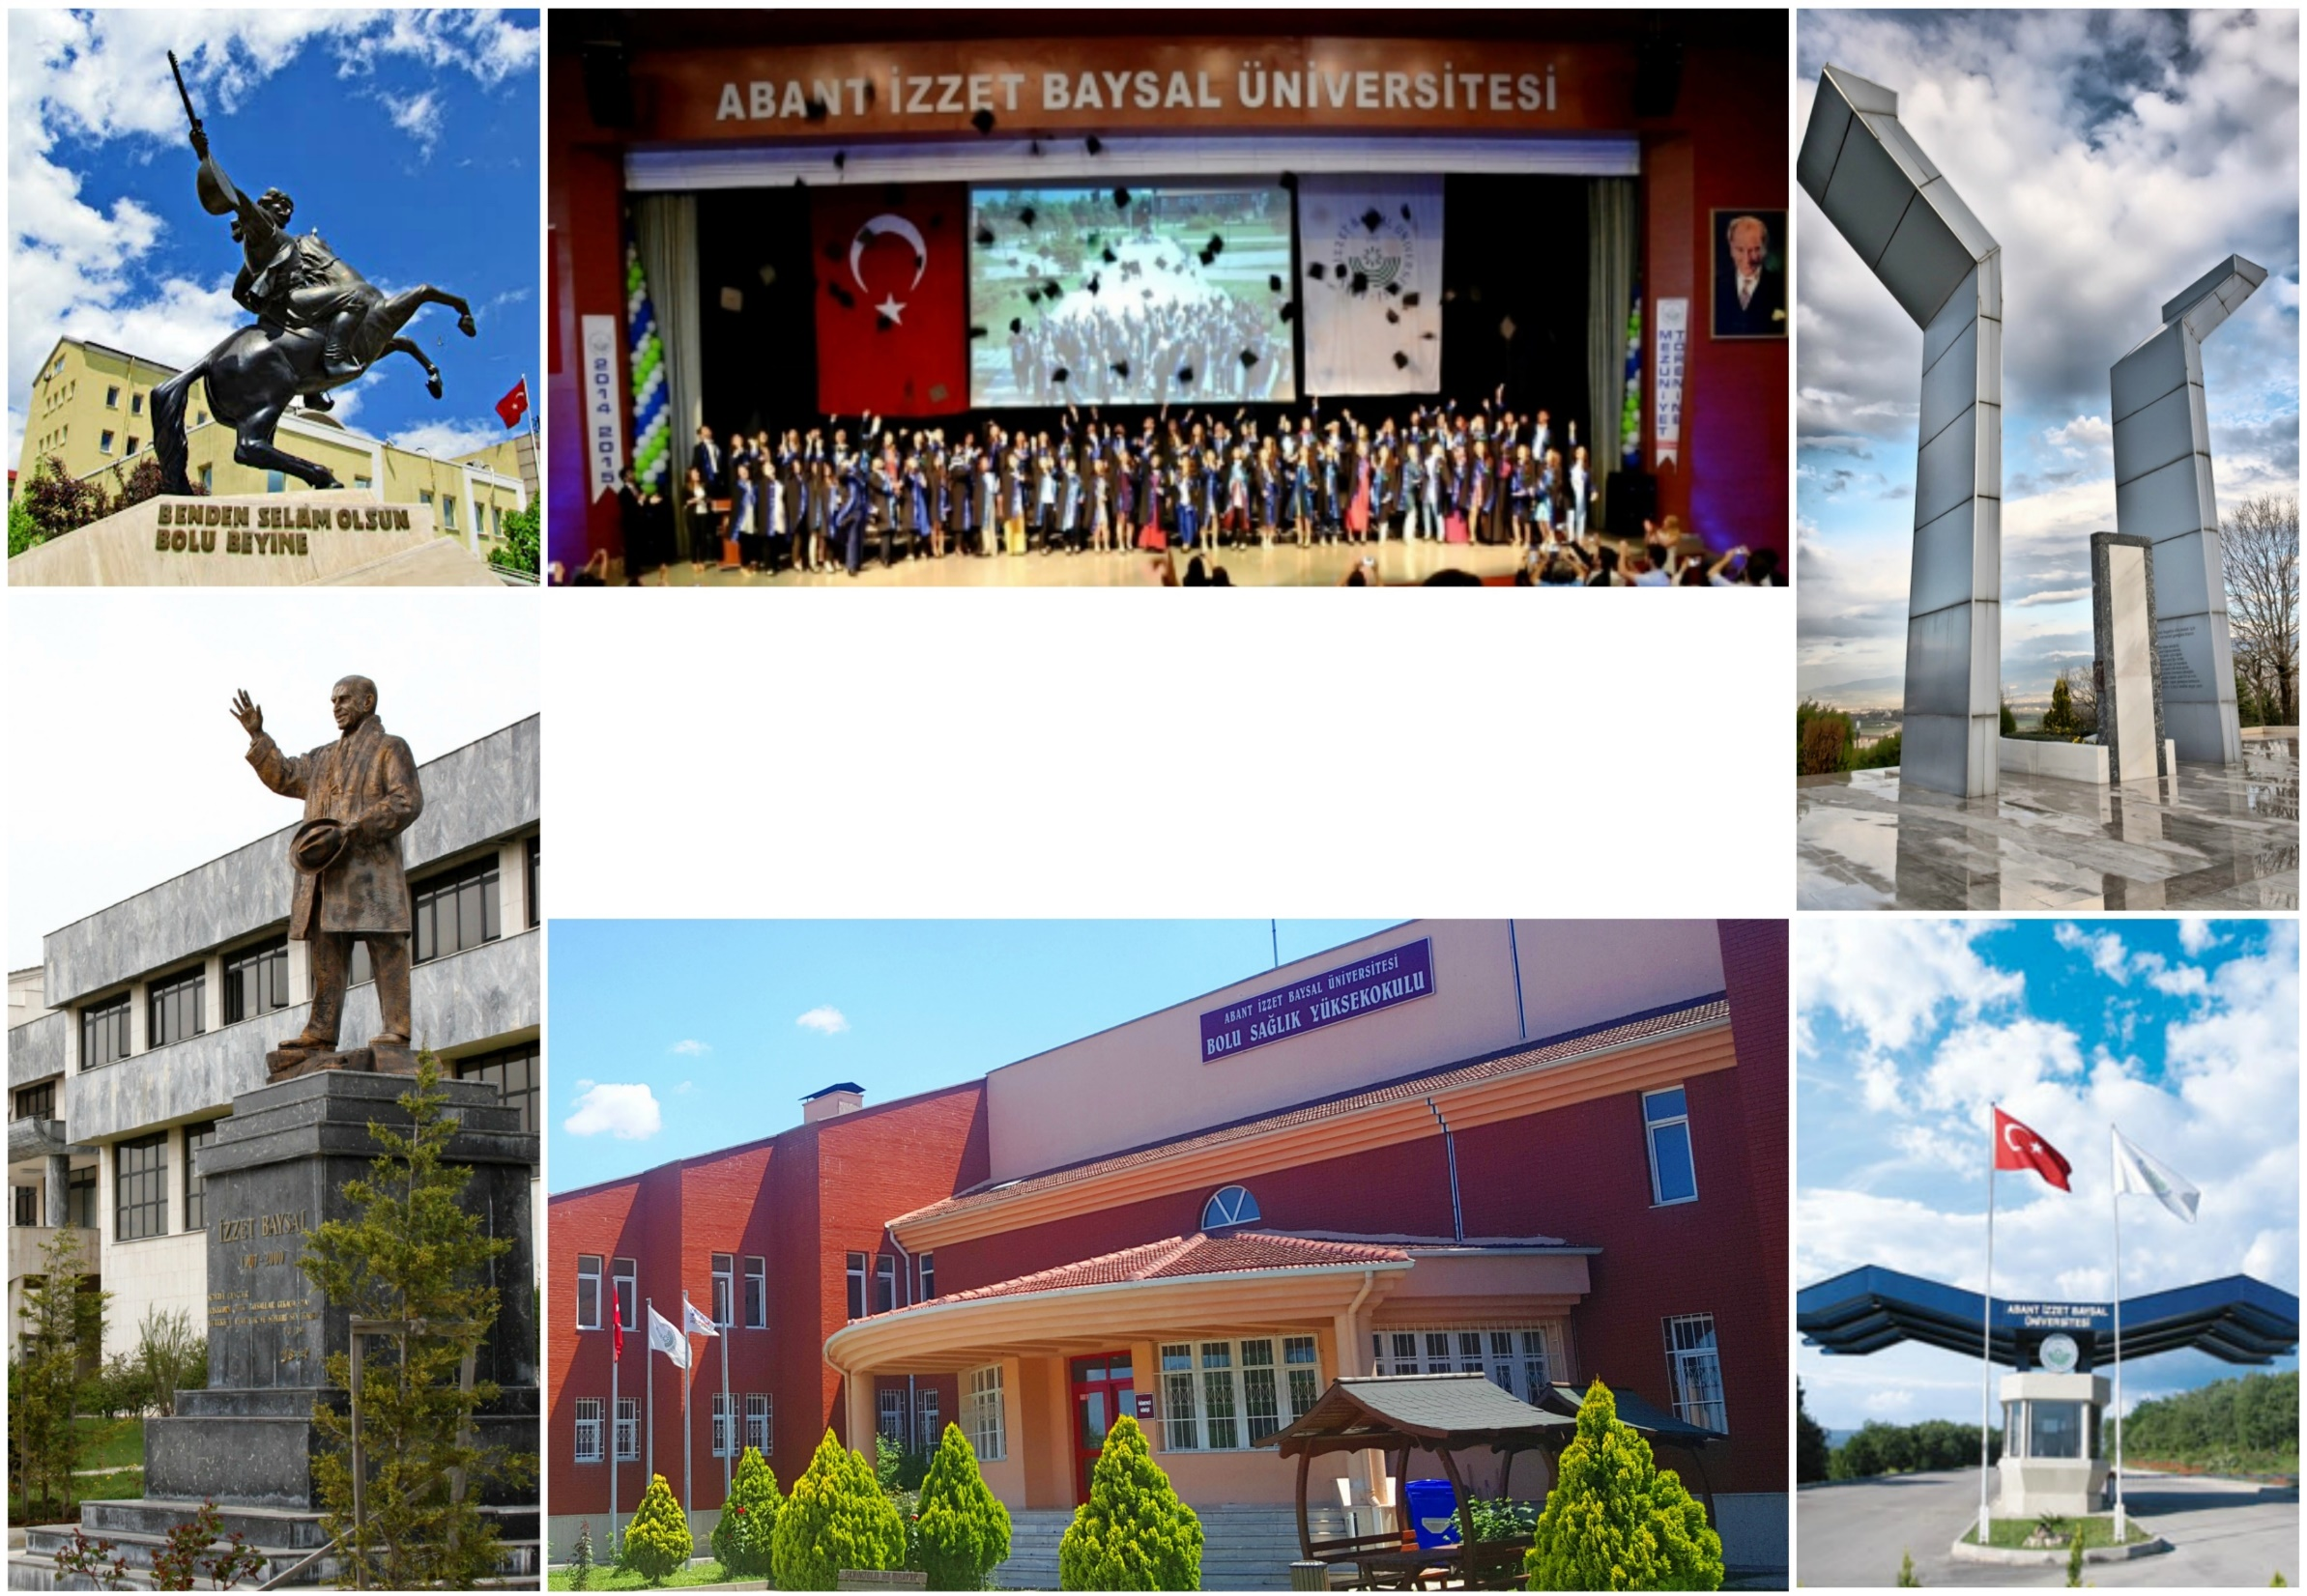

BOLU ABANT IZZET BAYSAL UNIVERSITY
FACULTY OF HEALTH SCIENCES
DEPARTMENT OF NURSING

Slide 2
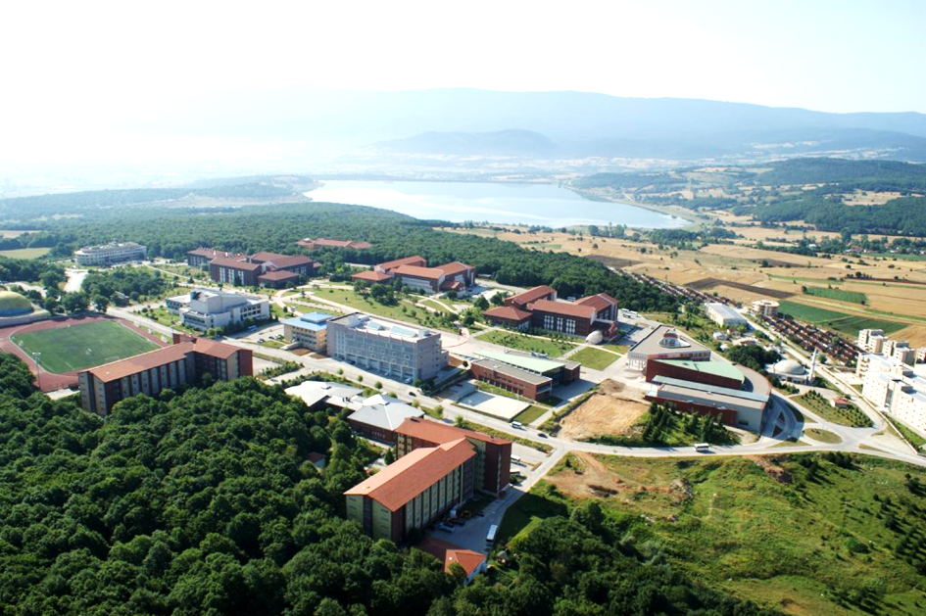
Bolu Abant Izzet Baysal University, one of the most distinguished universities of our country, surrounded by natural beauty between the two metropolitan cities of Turkey, Ankara and Istanbul, was established on July 3, 1992. Our University, which has developed rapidly since this date, has campuses in Bolu city center and three districts (Gerede, Mengen, Mudurnu). Izzet Baysal Campus, the central campus of our university, is located in Gölköy, 8 km from Bolu city center, in a unique natural beauty.Our university currently has 16 faculties, 1 institute, 1 college, 8 vocational schools and 21 research centers. The 1,400 academic staff and 1,200 administrative staff working in these units of our university are proud to offer a quality and modern education environment to approximately 33,000 students.Founded in 1992 in Bolu, Bolu Abant Izzet Baysal University constitutes a different model as a “Foundation Supported State University” apart from state and foundation universities.
Bolu Abant Izzet Baysal University

Slide 3
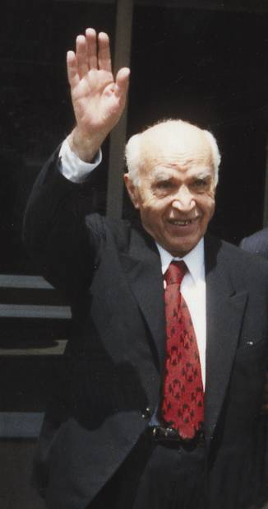


İzzet Baysal (1907-∞)
He was born in 1907 in Bolu. He completed his primary and secondary education in Bolu and his higher education as an architect at Istanbul Fine Arts Academy.
Baysal started his professional life as a civil servant and became an industrialist by establishing Temper Casting Factory in 1949. He played a pioneering role in the development of the casting industry in Turkey.
For years, he was among the top ten highest income tax payers in Istanbul.In 1987, he established the İzzet Baysal Foundation, which he called “my greatest work”, by allocating from his tax-paid earnings. İzzet Baysal Foundation has realized 141 facilities until 2018.
Izzet Baysal's charitable works range from village health centers to full-fledged hospitals, from mosques to nursing homes, from kindergartens to universities.

Slide 4
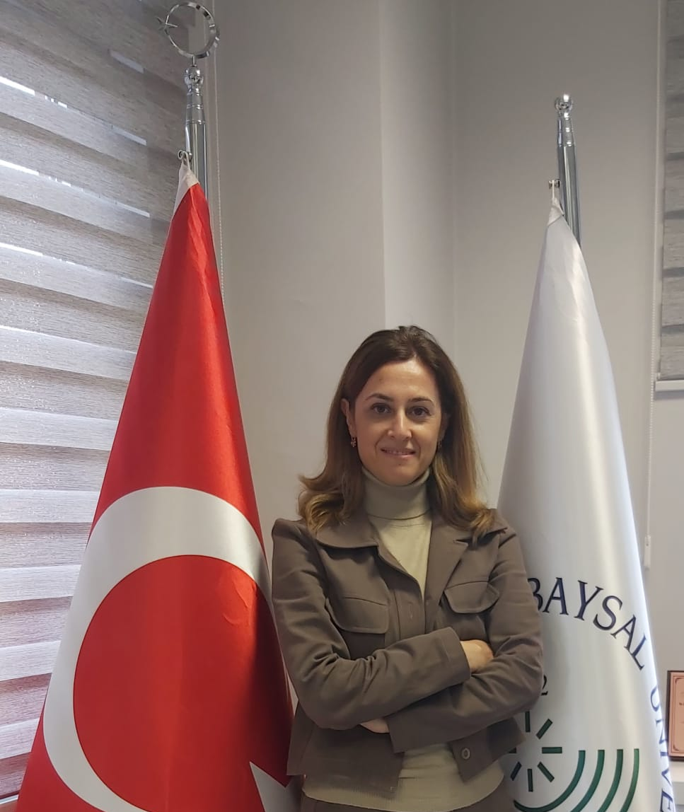
Dear Students;
Nursing is a profession that dates back to the beginning of human existence, takes its source from human needs, and offers care professionally with its contemporary roles in the protection, development and maintenance of health. Our university's Nursing Department has been conducting a nursing undergraduate program for a quarter of a century.
Our department continues its undergraduate education, which started as the School of Health in 1997, as the Faculty of Health Sciences, Department of Nursing since 2019. Our department aims to train qualified graduates who will successfully represent our profession by taking into account humanitarian and professional values at national and international level with its expert academic staff, and also educates nurses who have science experts and doctoral degrees with our master's and doctoral education.We prioritize the achievement of the highest level of health and well-being of the individual, family and society with our studies including nursing education, research and practice.
In this context, we constantly evaluate and innovate our education and training programs and processes; we take care to provide you with the most appropriate learning experiences in theoretical, laboratory and practical areas. As the Department of Nursing, we aim to maintain our education quality by certifying it. I congratulate you for choosing to study in our department, welcome you and wish you success in your educational life.
Love and Best Regards
Prof. Dr. Birgül CERİT
Head of Nursing Department

Slide 5
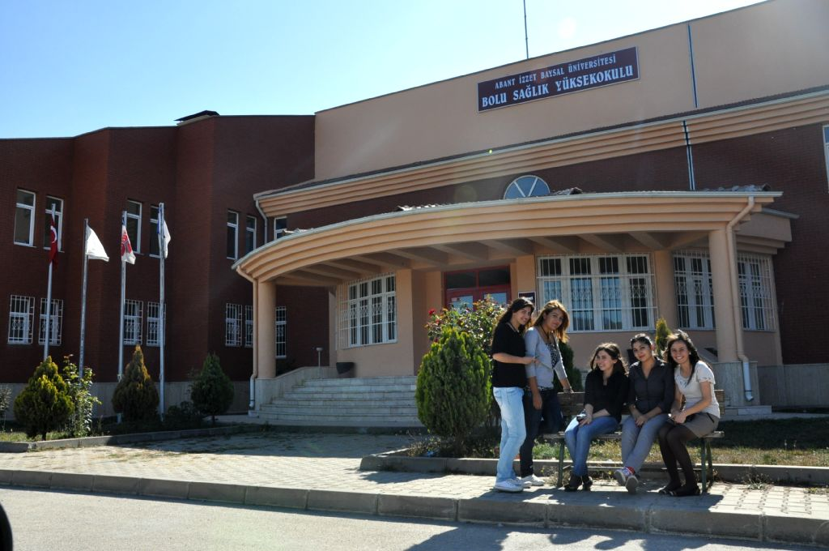
Department of Nursing
In 1993-1994 academic year, Nursing Associate Degree Program was opened within Bolu Vocational School of Health Services. On 16.01.1997, it was transformed into Bolu School of Health.
It was closed with the decision of the Presidency dated 25.01.2019 and numbered 669, and the Faculty of Health Sciences Nursing Department started education and training in the spring semester of the 2018-2019 academic year.
Undergraduate education and training has been continuing in our nursing department since 1997-1998. In addition to the master's program, the Department of Nursing Doctorate Program was opened at the beginning of the spring semester of the 2014-2015 academic year.
As of the 2024-2025 academic year, the number of students enrolled in our department is 859.

Slide 6

Number of Students
Academic year | Number of Students
2012-2013 | 285
2013-2014 | 449
2014-2015 | 566
2015-2016 | 664
2016-2017 | 718
2022-2023 | 866
2023-2024 | 857
2024-2025 | 859

Slide 7
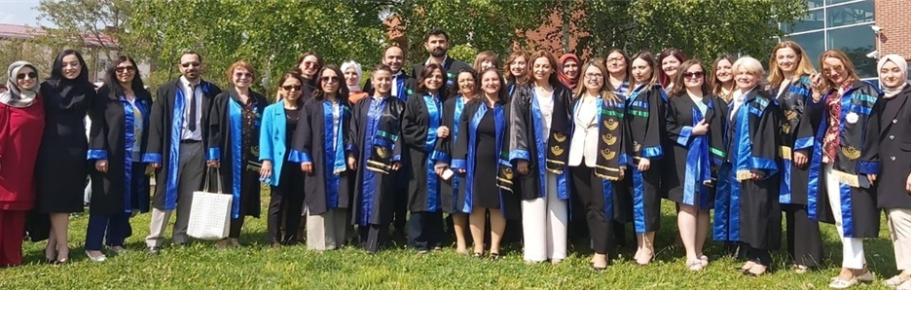
In our department, education, counseling and research activities are carried out by 4 professors, 5 Assoc. Prof. Dr., 14 Assist Prof., 3 lecturers and 7 research assistants.

Slide 8
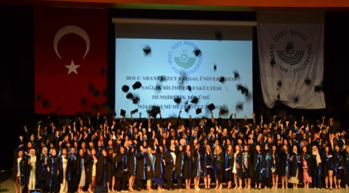
Mission of our department;
To educate nurses with ethical values who realize the contemporary roles of nursing by following scientific developments and adopting lifelong learning in protecting, developing and maintaining the health of the individual, family and society in a holistic manner.
Vision of our Department;
To be a pioneering and preferred nursing education institution at national and international level in the fields of education, research and practice.
Core Values
Commitment to Ethical Values Participation
Entrepreneurship and Innovation
Professionalism Social Contribution
Corporate Belonging

Slide 9
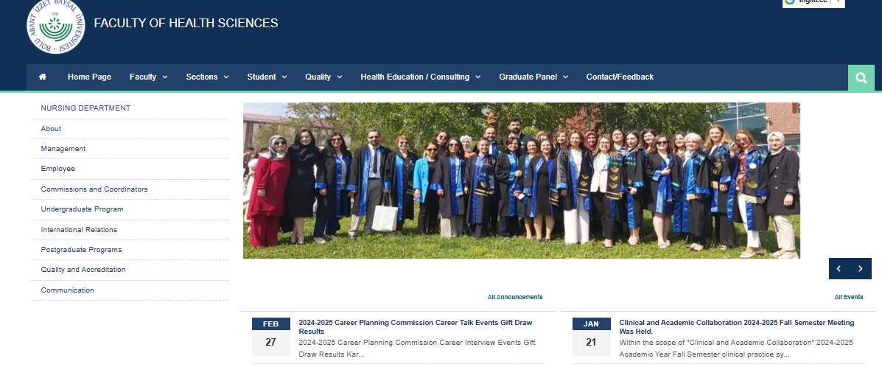
Department website
http://hb.sbf.ibu.edu.tr

Slide 10

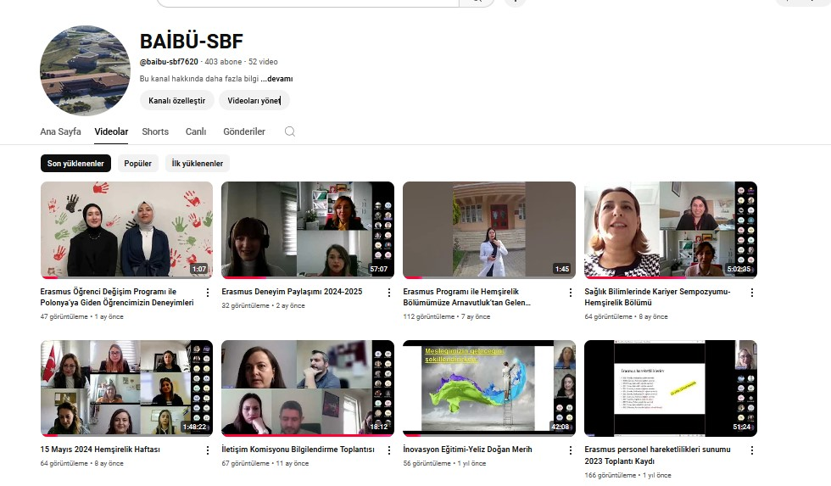
YouTube account of our faculty, where scientific meetings and webinars of our department are also broadcast

Slide 11
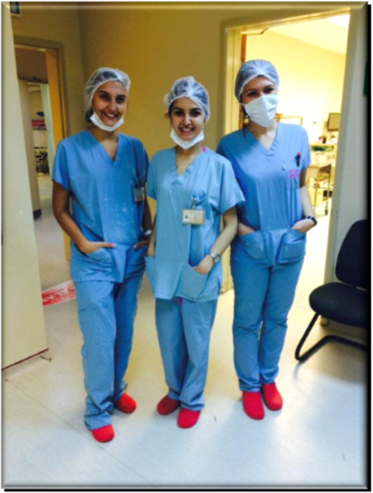

Department of Nursing
The aim of our undergraduate program is to train modern and professional nurses who understand the values and behaviors of human beings, who can identify the needs of healthy or sick individuals and who are equipped with the knowledge, skills and competencies to provide services in line with scientific developments in all areas of the nursing profession, who have internalized ethical values and have adopted the importance of lifelong learning.
During their undergraduate education, our undergraduate students receive theoretical education in classrooms, application laboratories, as well as practical training in public and private health institutions providing therapeutic and rehabilitative services. At the end of undergraduate education, our students graduate with the title of “Nurse”.
Score Type: SAY
Duration of training: 4 yıl
Language of education: Türkçe
Base score: 359,52
Ceiling score: 424,267

Slide 12

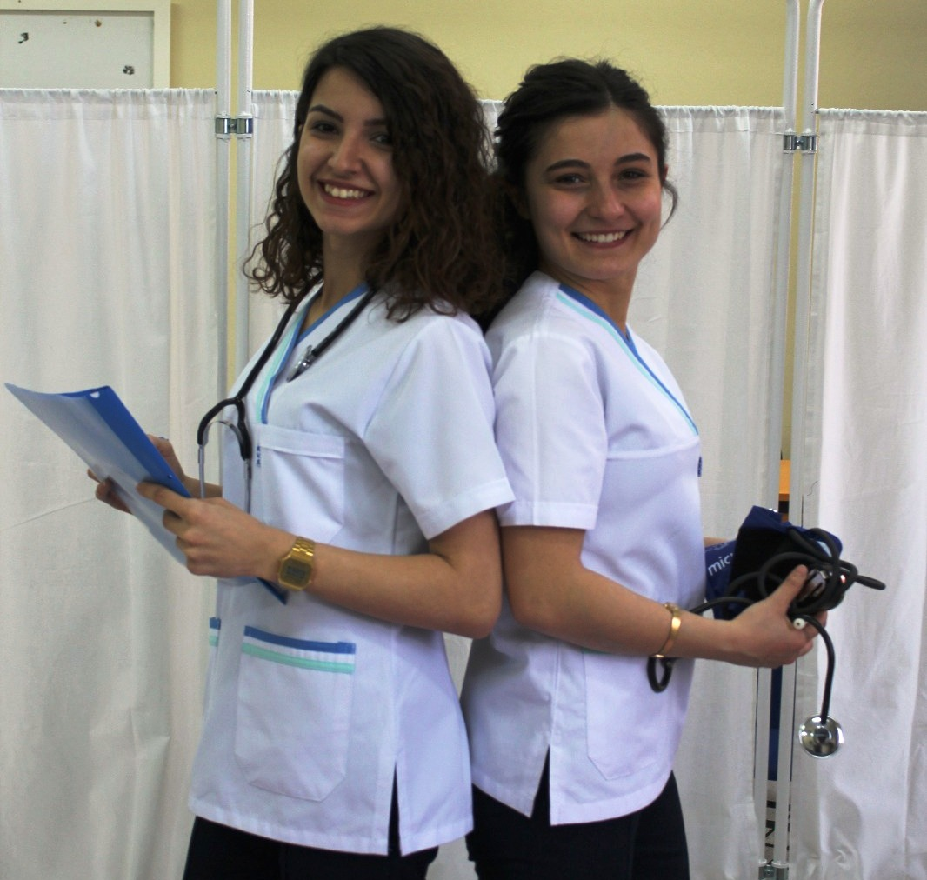
Department of Nursing
Graduate Programs | Master's Degree with Thesis PhD (Students can choose courses for the fields they want)
Aim of the Master's Program | In order to make nursing services more effective and efficient, it is aimed to train specialist nurses who have planning, organizing, supervising and developing characteristics; who can use knowledge, skills and advanced technology effectively within the understanding of quality service; who can plan education based on research findings; who can communicate effectively with different segments of society; who can follow scientific developments and use them in professional and academic fields; who are inquisitive and researcher..
Aim of the PhD Program | The aim of this course is to enable the students to specialize in the basic subjects specific to nursing and the theories, concepts, principles and methods on which they are based, and to gain the ability to reach new syntheses by conducting independent and original scientific research.
Graduate Education Programs
In addition to undergraduate education in Nursing, Nursing Master's Degree with Thesis and Nursing Doctorate programs are also carried out under the Department of Nursing within the Institute of Graduate Education.

Slide 13
NURSING DEPARTMENT ORGANIZATION CHART
Education Commission
Measurement and Evaluation Commission
Applied Trainings Commission
Quality Commission
Career Planning Commission
Graduate Follow-up And Evaluation Commission
Interinstitutional Horizontal Transition Commission
Central Placement Horizontal Transition Commission
Vertical Transition Commission
Nursing Week Events Commission
International Relations Department Coordination
Head of Nursing Department
Prof. Birgül CERIT
Vice President of Department
Asst.Prof. Mehmet KARAKAS
Vice President of Department
Asst.Prof. Şeyma DEMIR ERBAS
Commissions and Coordinators
Faculty Secretary
Ergün BOZMAZ
Department of Fundamentals of Nursing
Prof. Dr. Birgul CERIT*
Asst. Prof. Simge COSKUN PALAZ
Asst. Prof. Saadet ERDEM
Asst..Prof. Sümeyra ALAN
Res. Asst. Gülnur GULSOY
Res. Asst. Mehmet Ali CALISKAN
Department of Internal Medicine Nursing
Prof. Dr. Yasemin YILDIRIM USTA*
Assoc. Prof. Dr. Saadet CAN CICEK
Asst..Prof. Arzu AKMAN YILMAZ
Asst..Prof. Seyma DEMIR ERBAS
Res. Asst. Dr. Elif GENCER SENDUR
Department of Surgical Diseases Nursing
Prof. Dr. Arzu OZCAN ILCE
Asst. Prof. Ganime Esra SOYSAL*
Asst. Prof. Ummuhan YIGIT
Lecturer Dr. Ebru CELEBI
Lecturer Hacer ALPTEKER
Res. Asst. Aykut TURGUT
Department of Child Health and Diseases Nursing
Assoc. Prof. Dr. Bedriye AK
Asst. Prof. Rabia KECIALAN
Asst. Prof. Cigdem CEYLAN*
Department of Obstetrics, Women's Health and Diseases Nursing
Assoc. Prof. Dr. Nevin CITAK BILGIN*
Lecturer Fatma AYHAN
Res. Asst. Mervenur BOYUK
Res. Asst. Büsra BOGA
Department of Public Health Nursing
Assoc. Prof. Dr. Makbule TOKUR KESGIN
Asst. Prof. Songul CAGLAR*
Asst. Prof. Seher ZENGIN
Asst. Prof. Eda CEKER
Department of Mental Health and Disease Nursing
Prof. Dr. Naxmiye YILDIRIM*
Asst. Prof. Mehmet KARAKAS
Asst. Prof. Eylem SUVEREN
Res. Asst. Melisa BULUT
Department of Nursing Management
Assoc. Prof. Dr Nurhan CINGOL*
*Head of Department

Slide 14
BACHELOR'S DEGREE PROGRAM IN NURSING
1. Semester
2. Semester
3. Semester
4. Semester
5. Semester
6.Semester
7.Semester
8.Semester

Slide 15

COMMISSIONS
COORDINATORSHIPS
Education Commission
Measurement and Evaluation Commission
Applied Trainings CommissionQuality Commission
Career Planning Commission
Graduate Follow-up and Evaluation Commission
Inter-institutional Transfer Commission
Central Placement Transfer Commission
Vertical Transfer Commission
Nursing Week Activities Commission
International Relations Coordinatorship
Farabi/Mevlana Coordinatorship
Bologna Coordinatorship
Career Coordinatorship

Slide 16
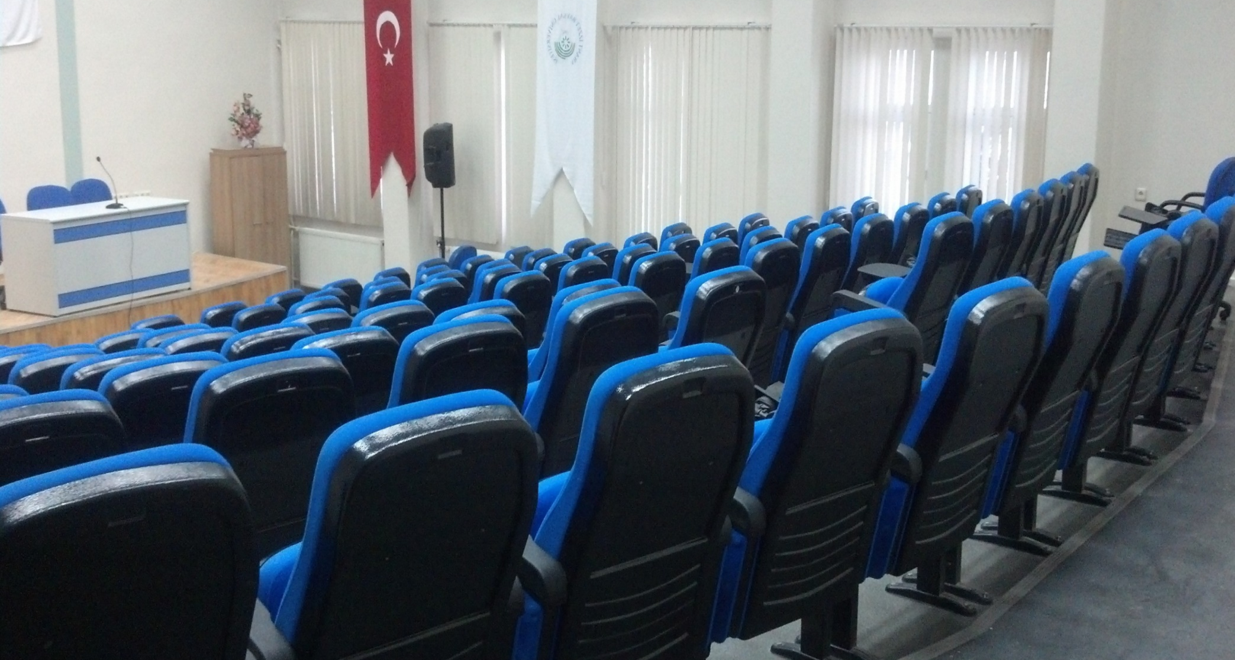
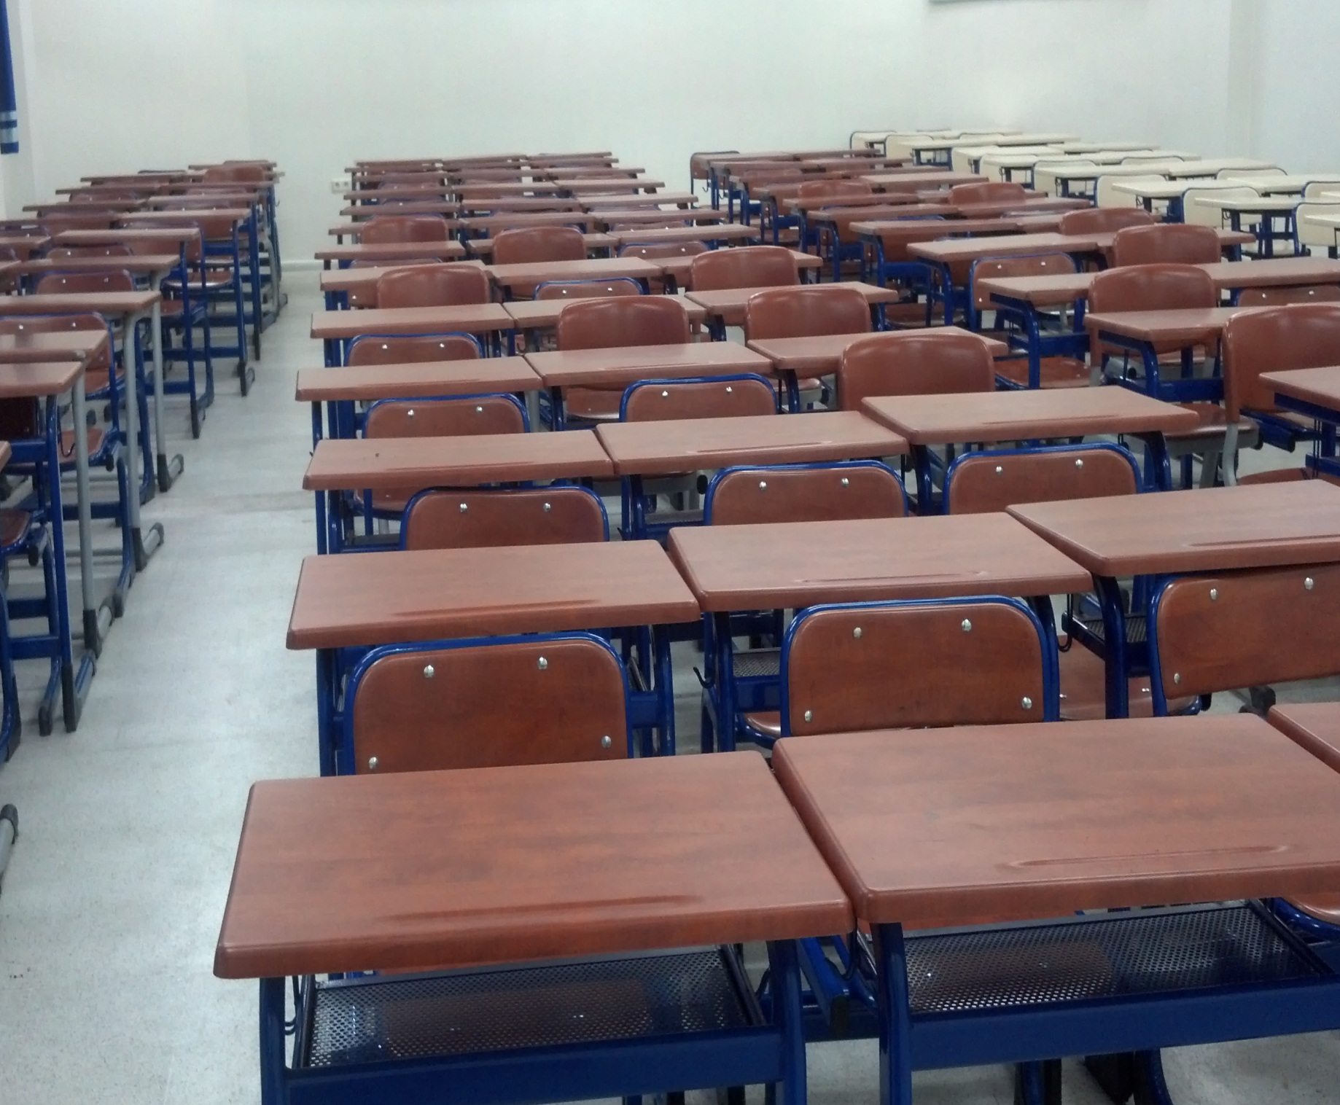
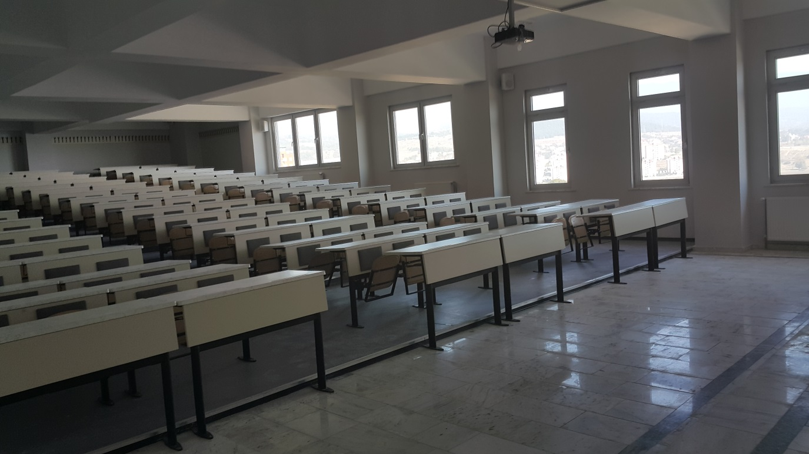
Our Physical Facilities
Nursing Practice Laboratory (6 units)
Izzet Baysal Amphitheater,
C Block lecture halls 2, 3 and 4
Classrooms

Slide 17
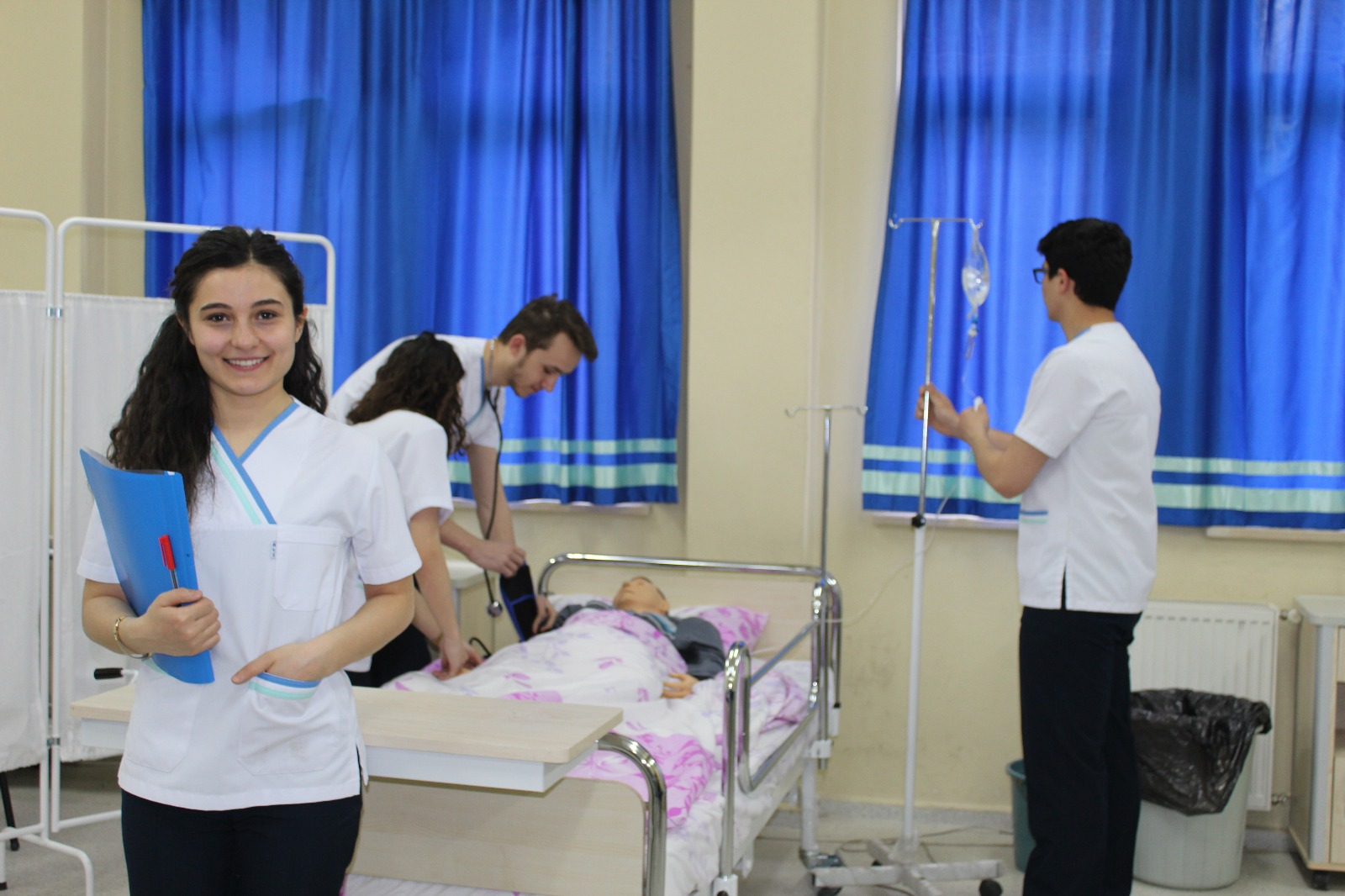
Nursing Practice Laboratories
Our students can apply what they have learned after the theoretical course and start clinical practice ready for clinical practice with 6 Nursing Practice Laboratories with equipped materials within our department.

Slide 18
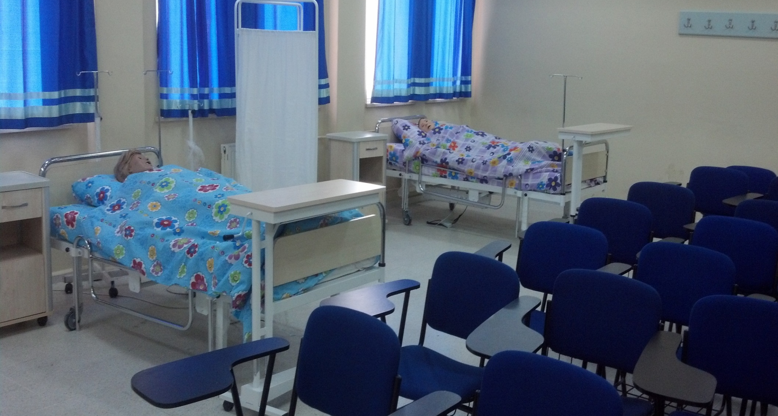
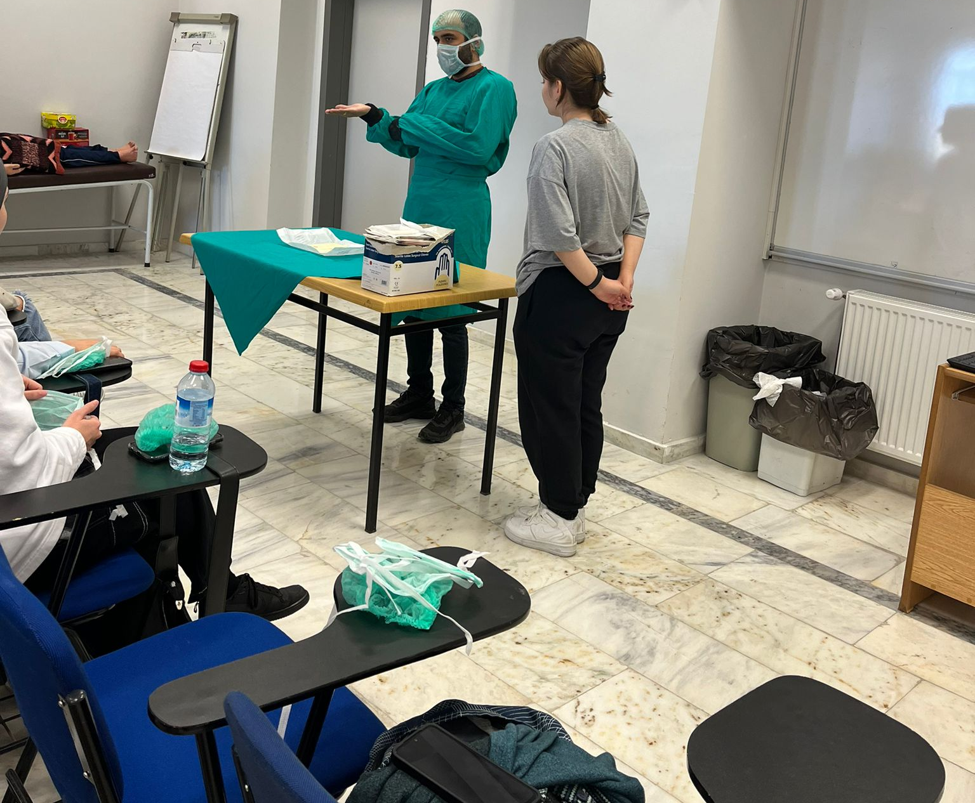
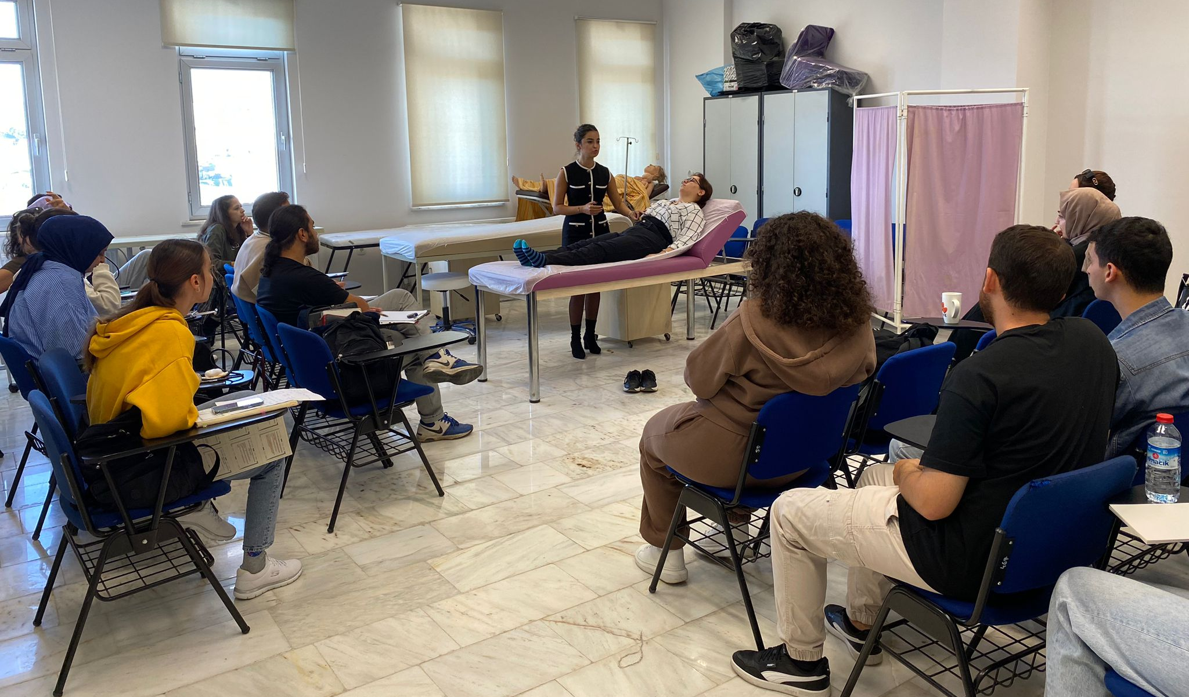
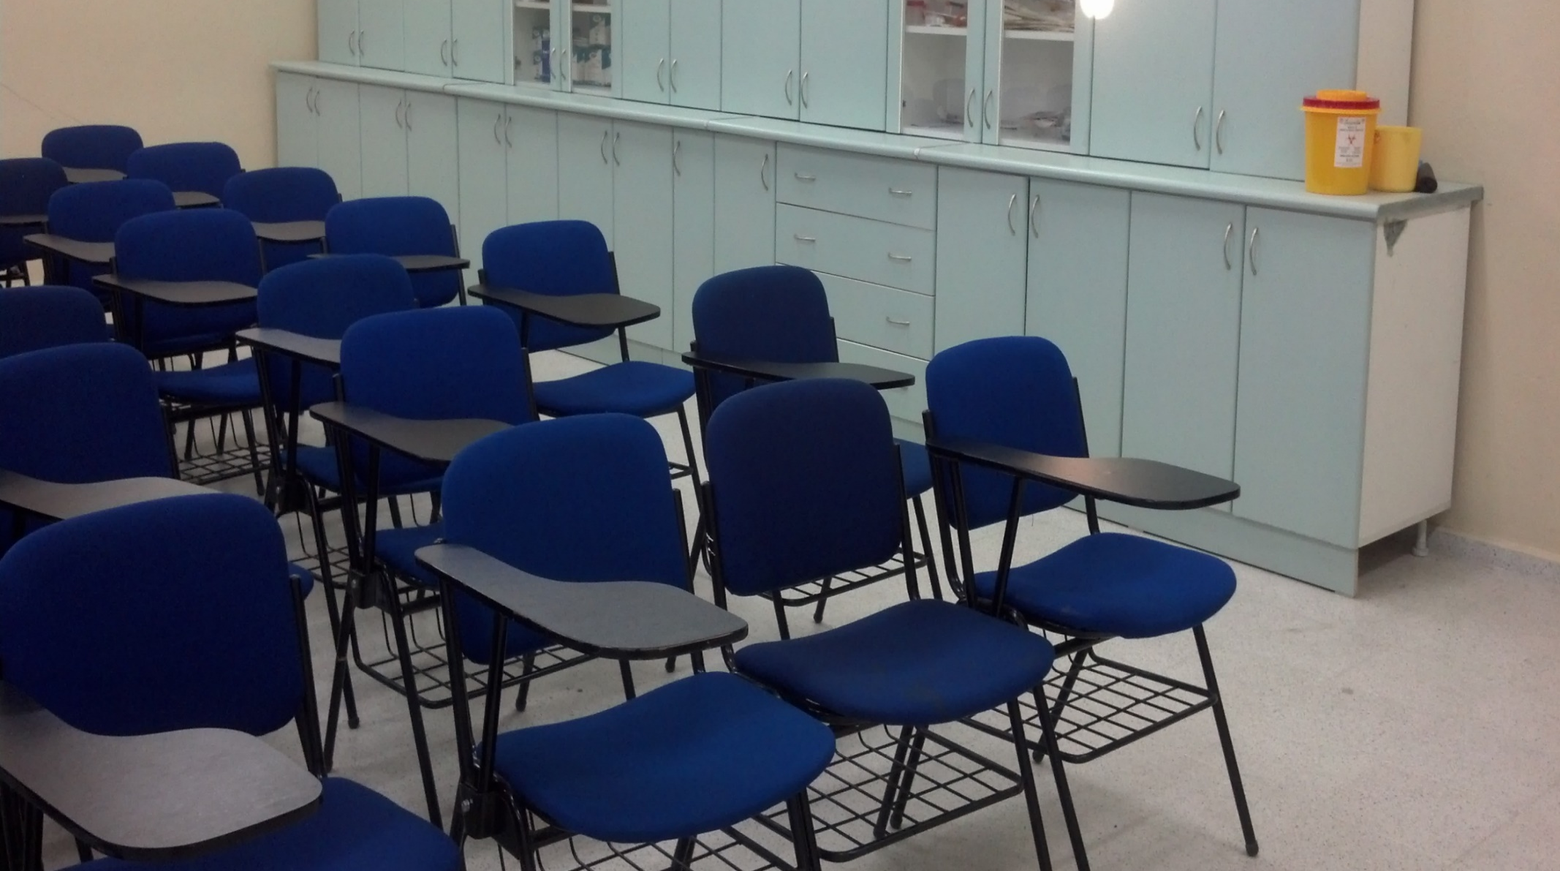

Slide 19
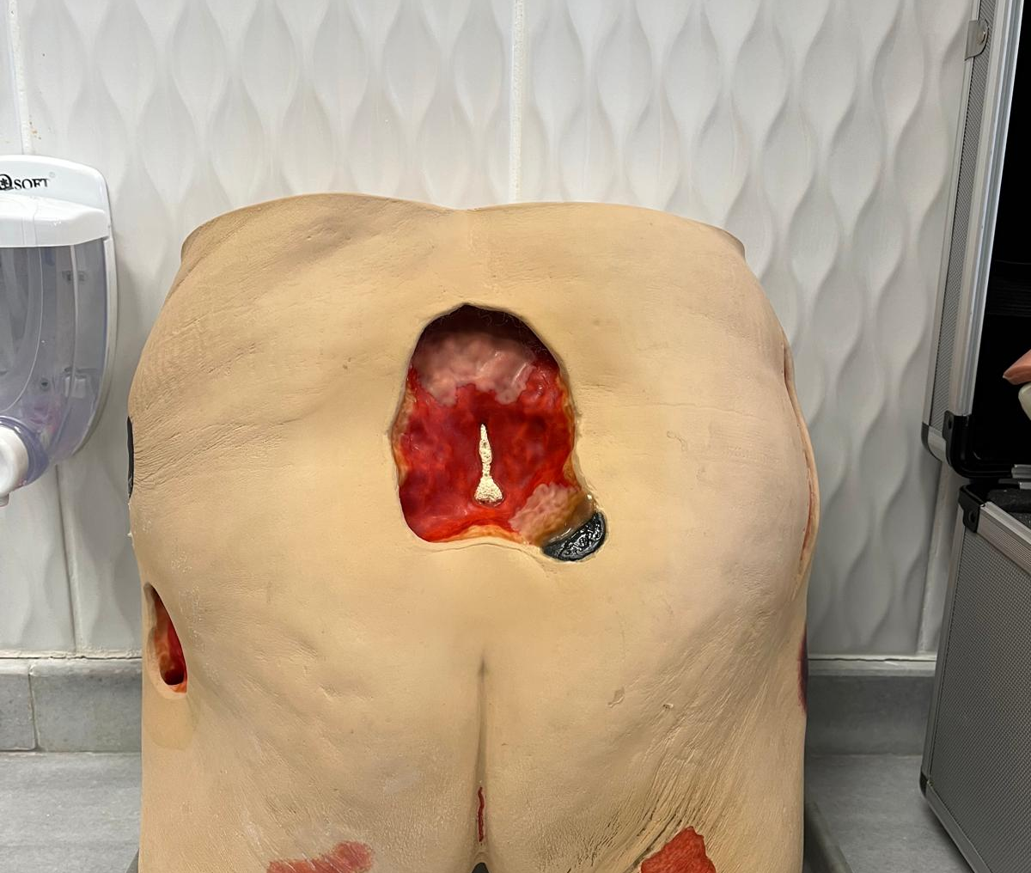
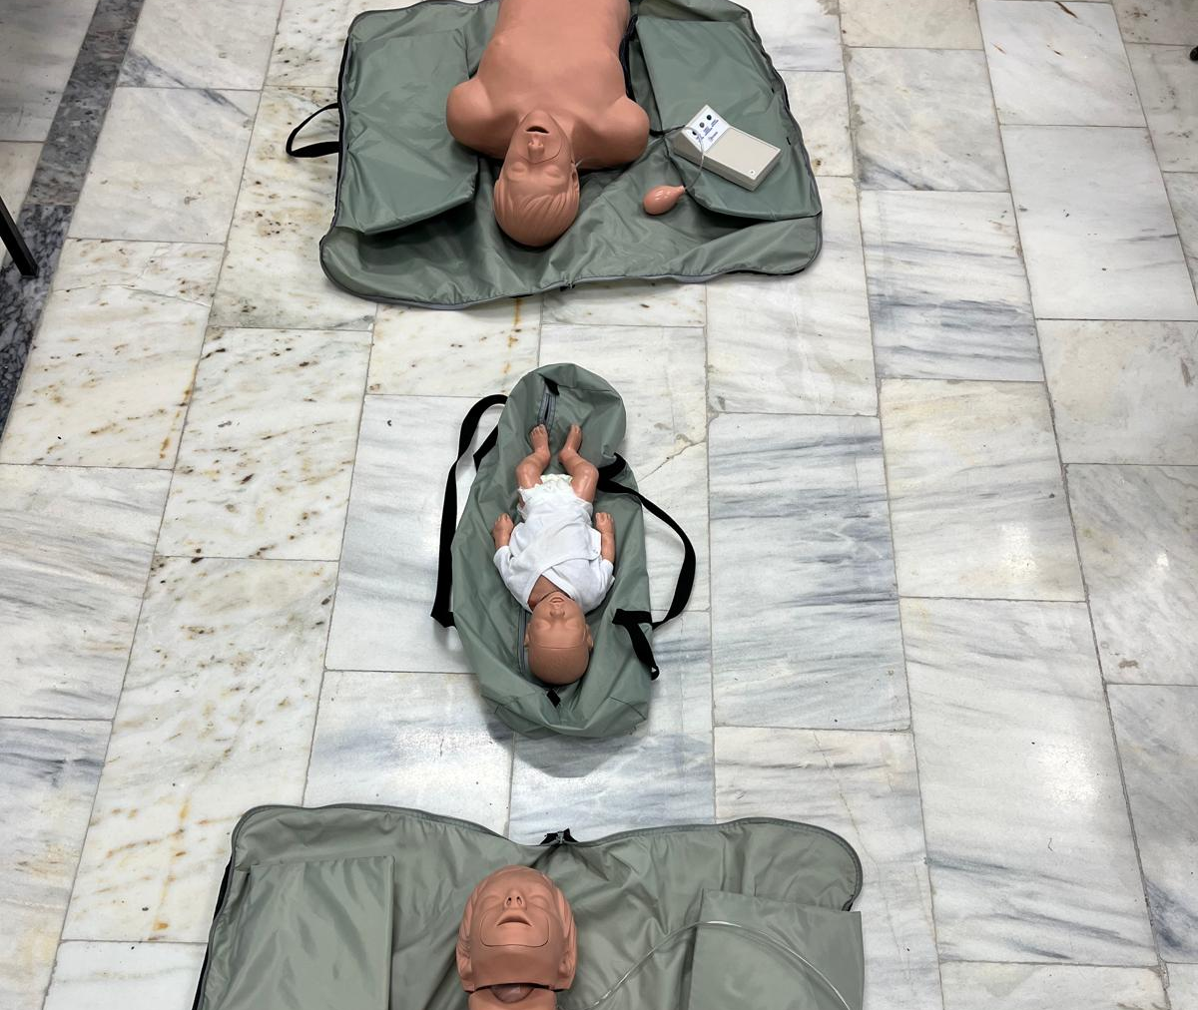
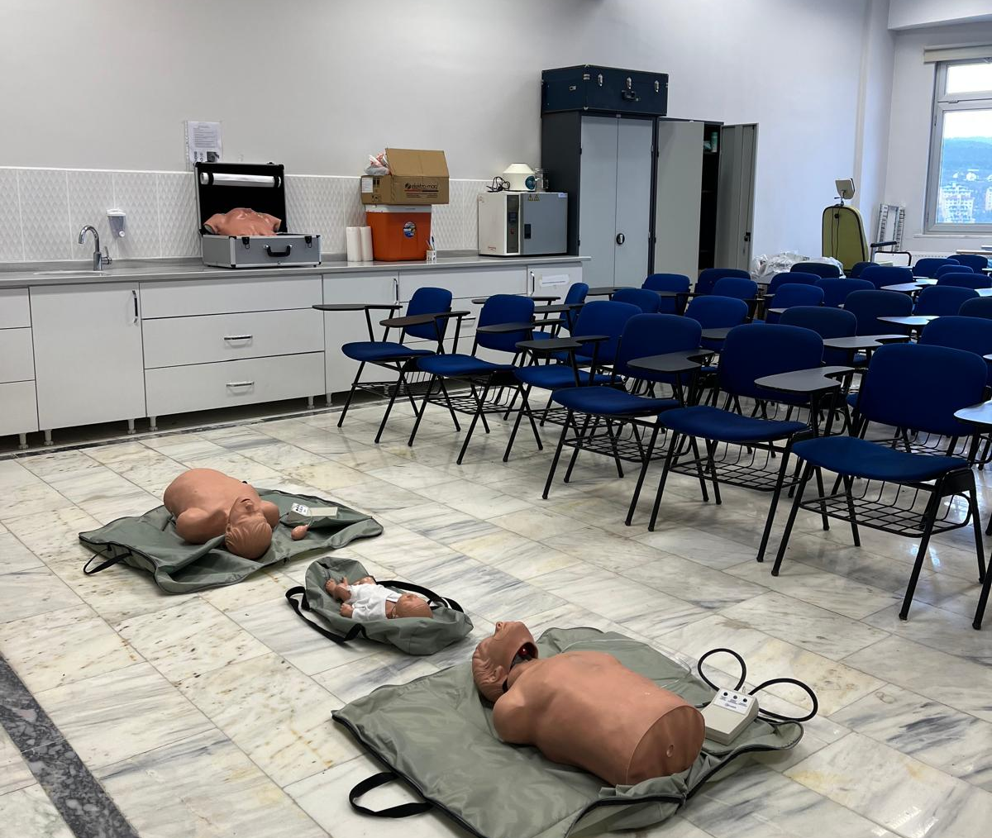
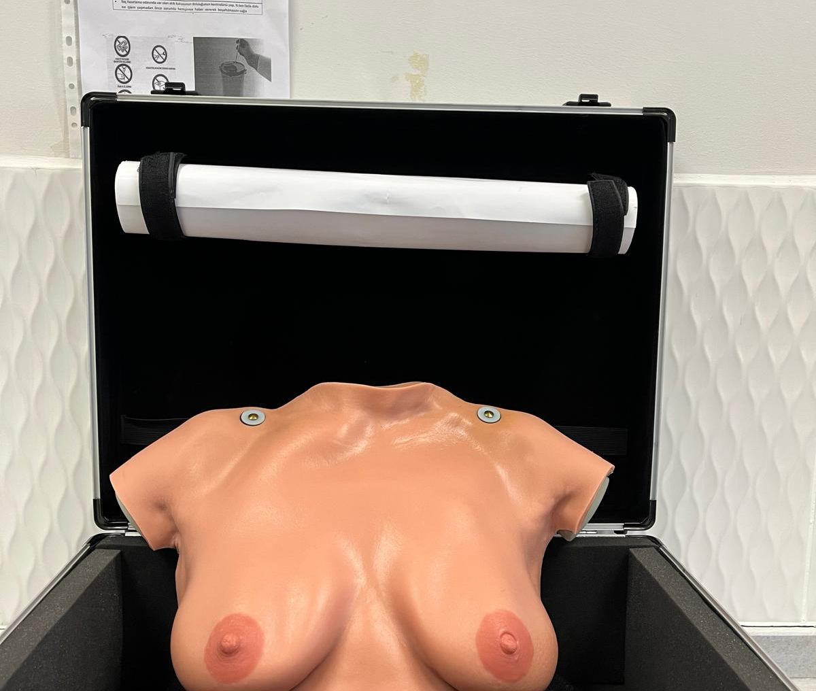
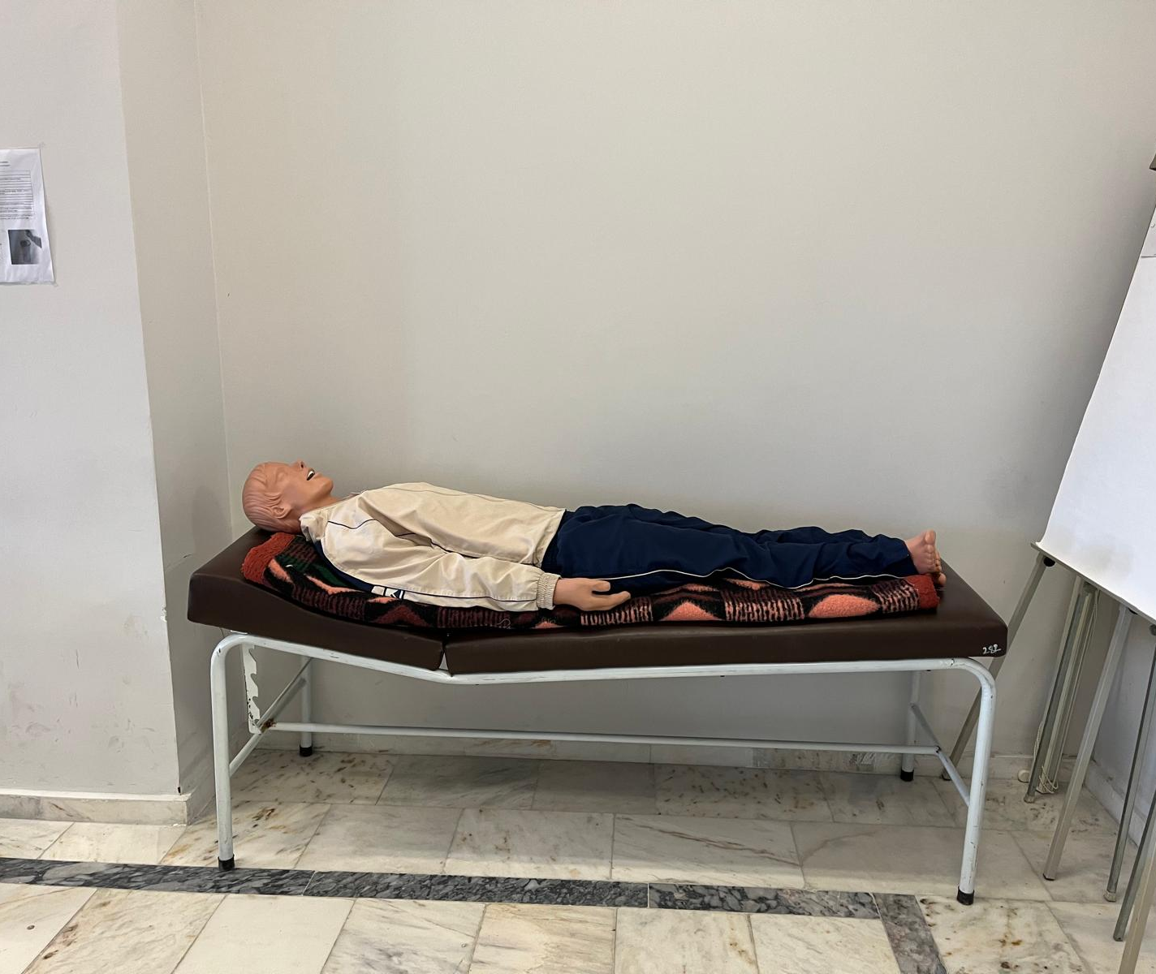
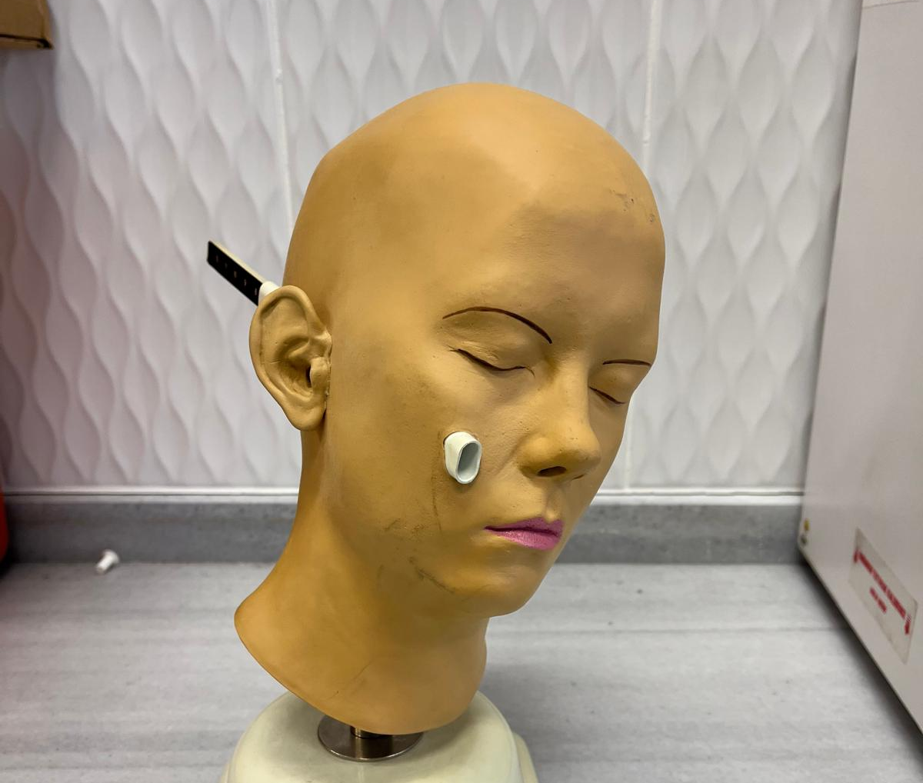

Slide 20
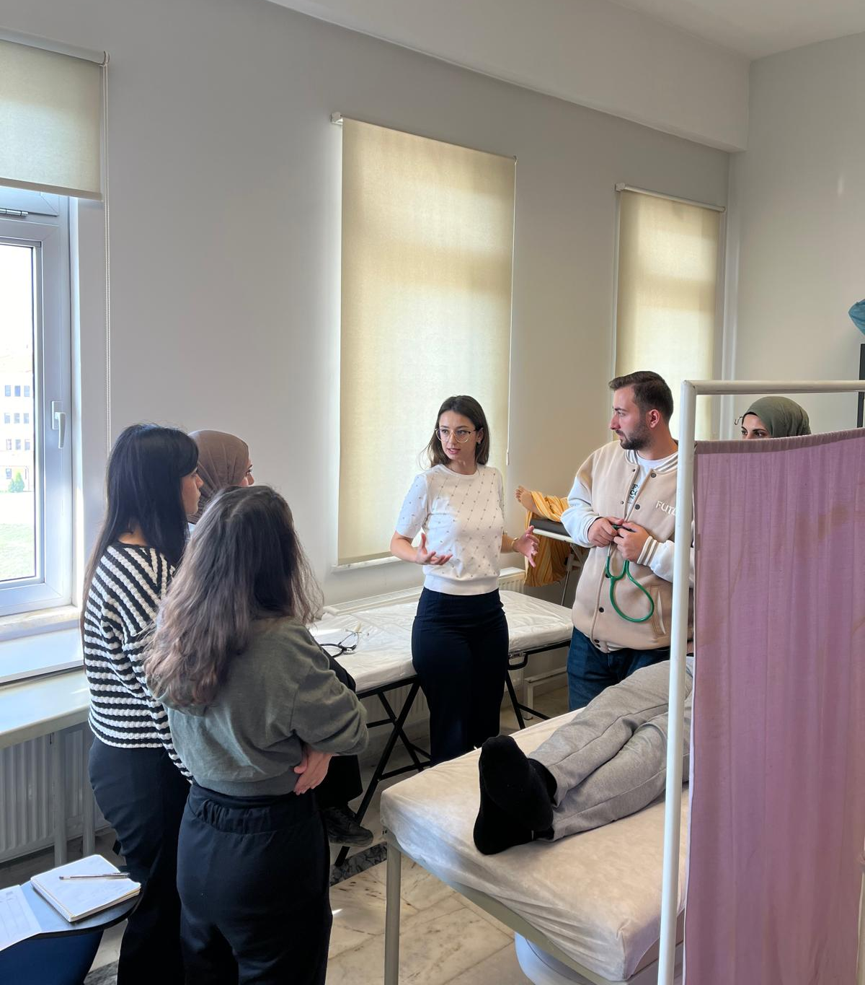
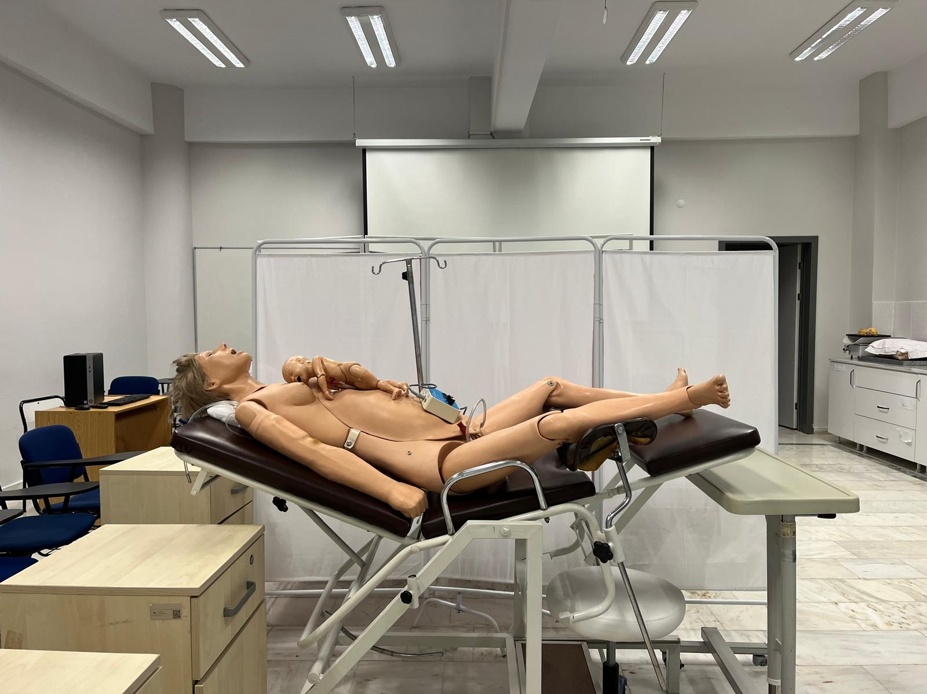

Slide 21
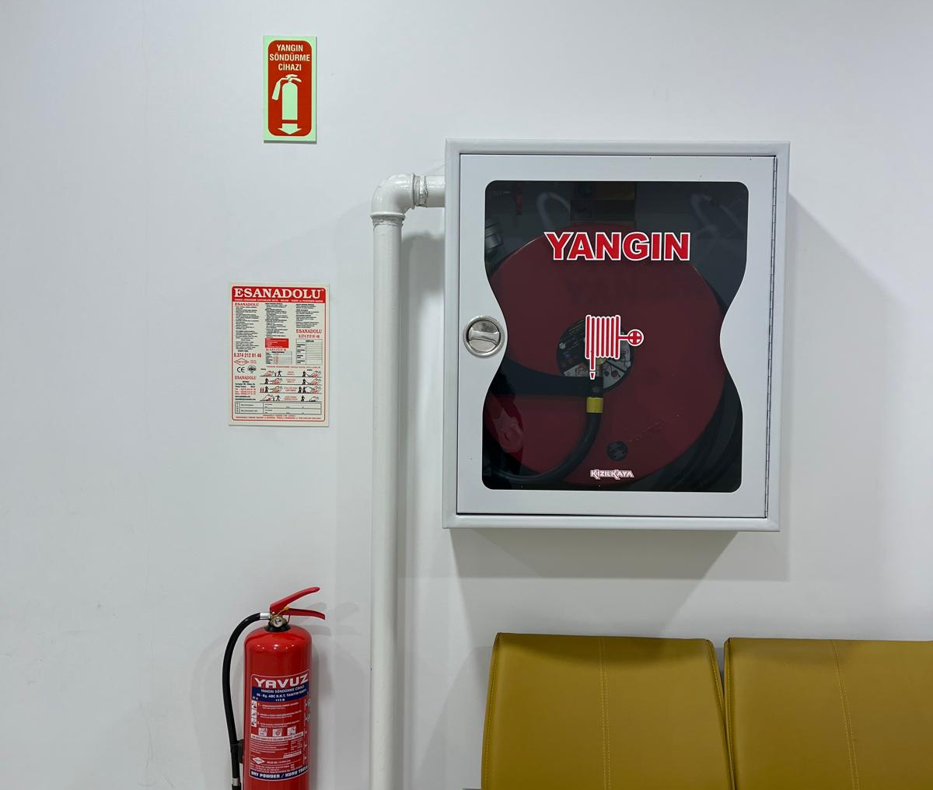
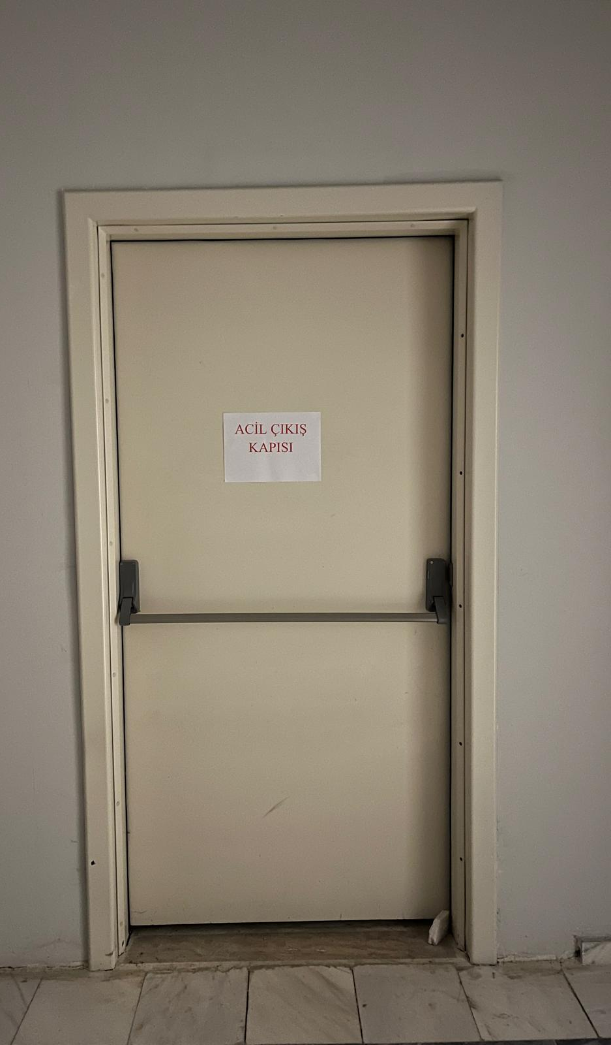
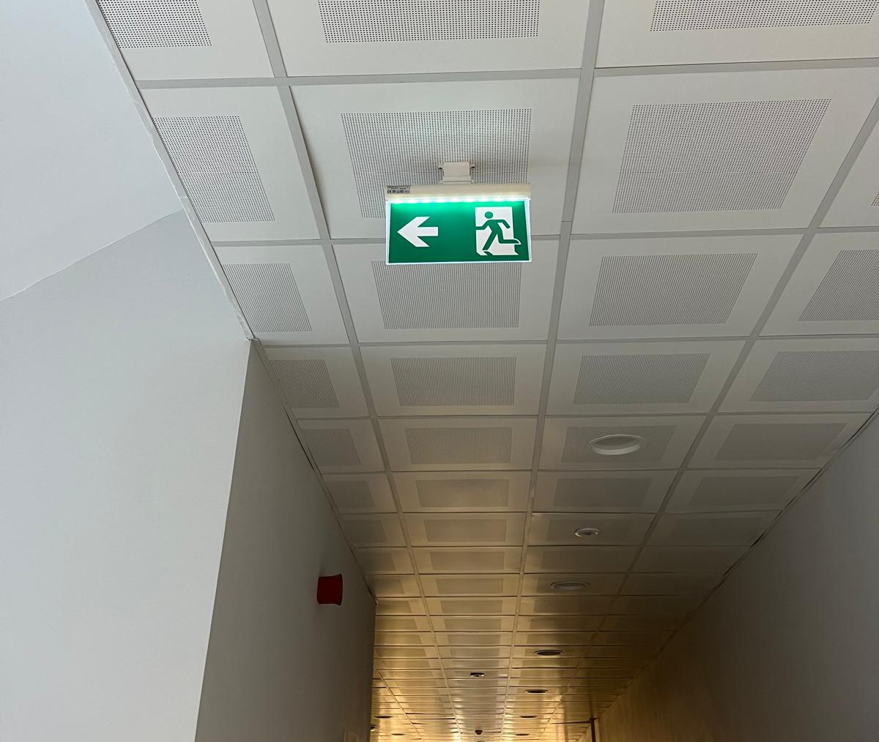
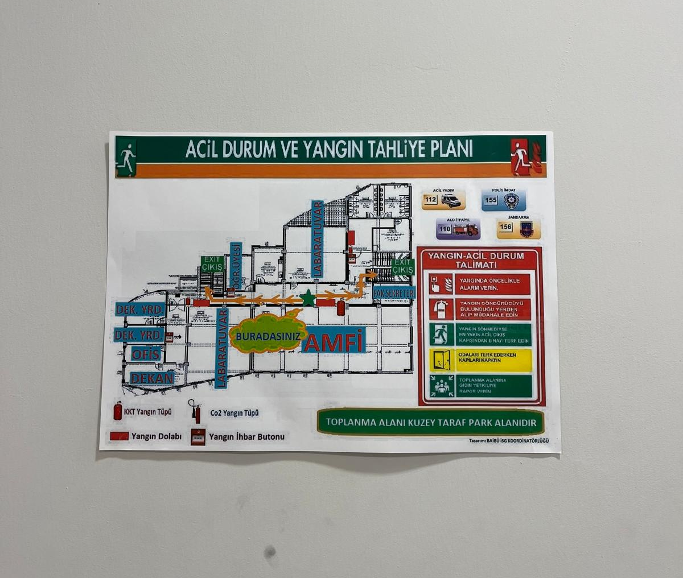
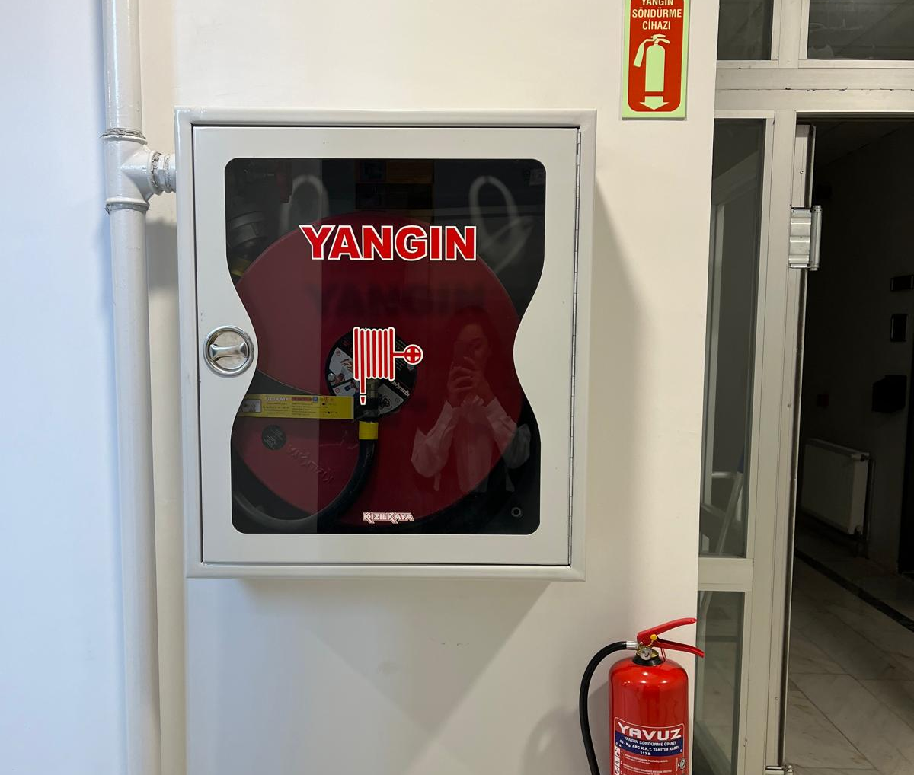
Emergency Plans

Slide 22
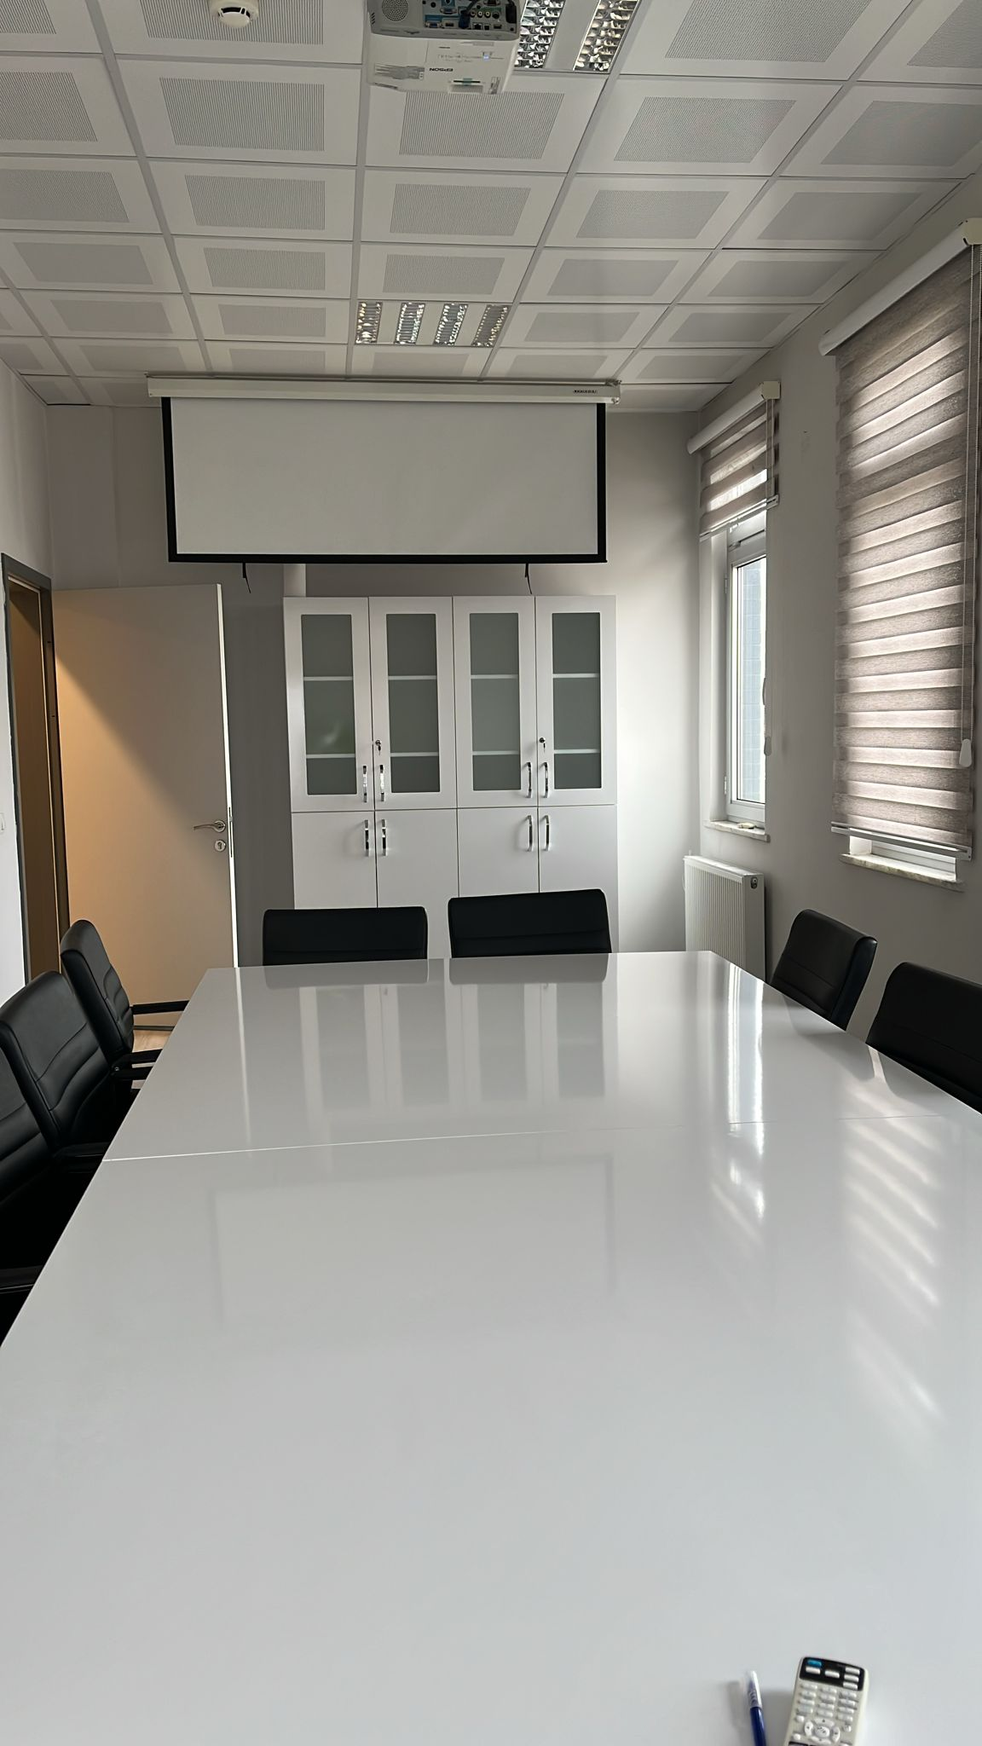

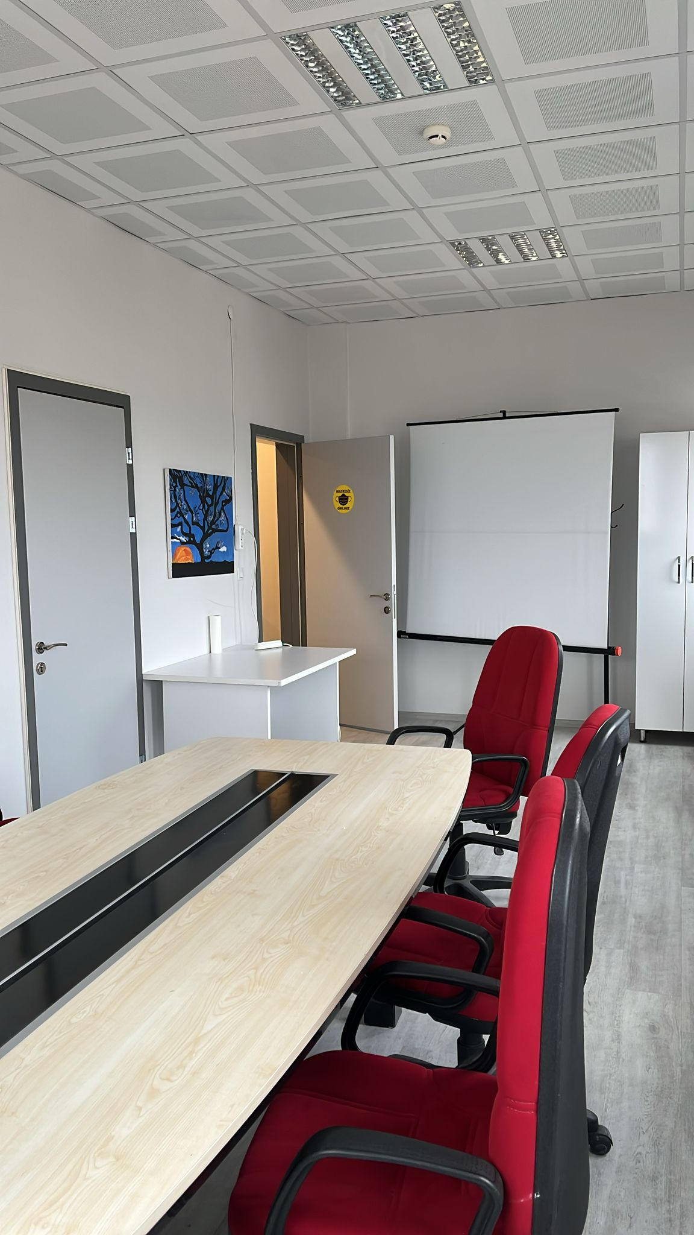
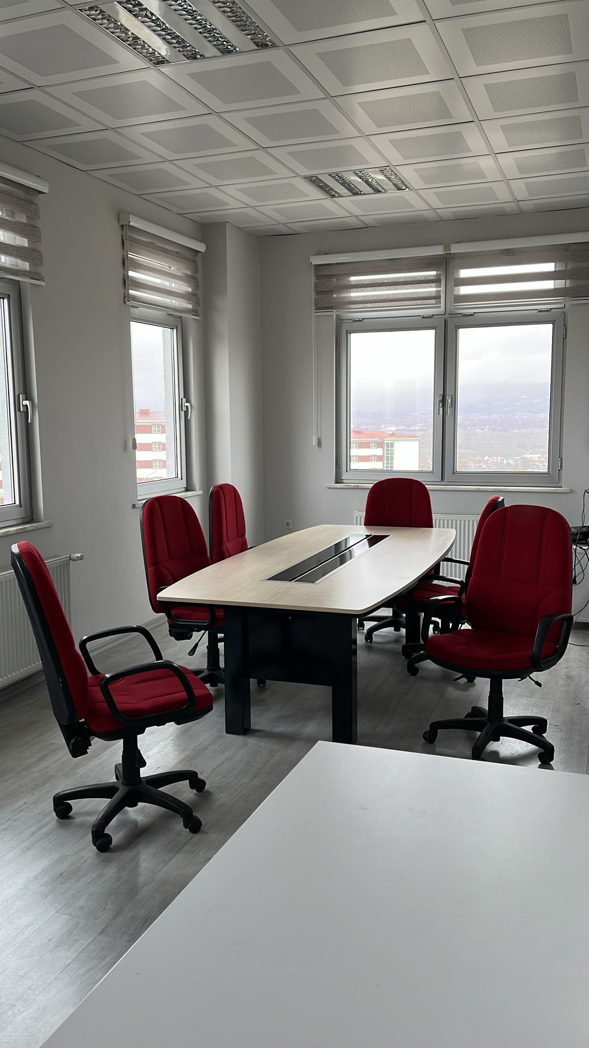
Meeting Rooms

Slide 23
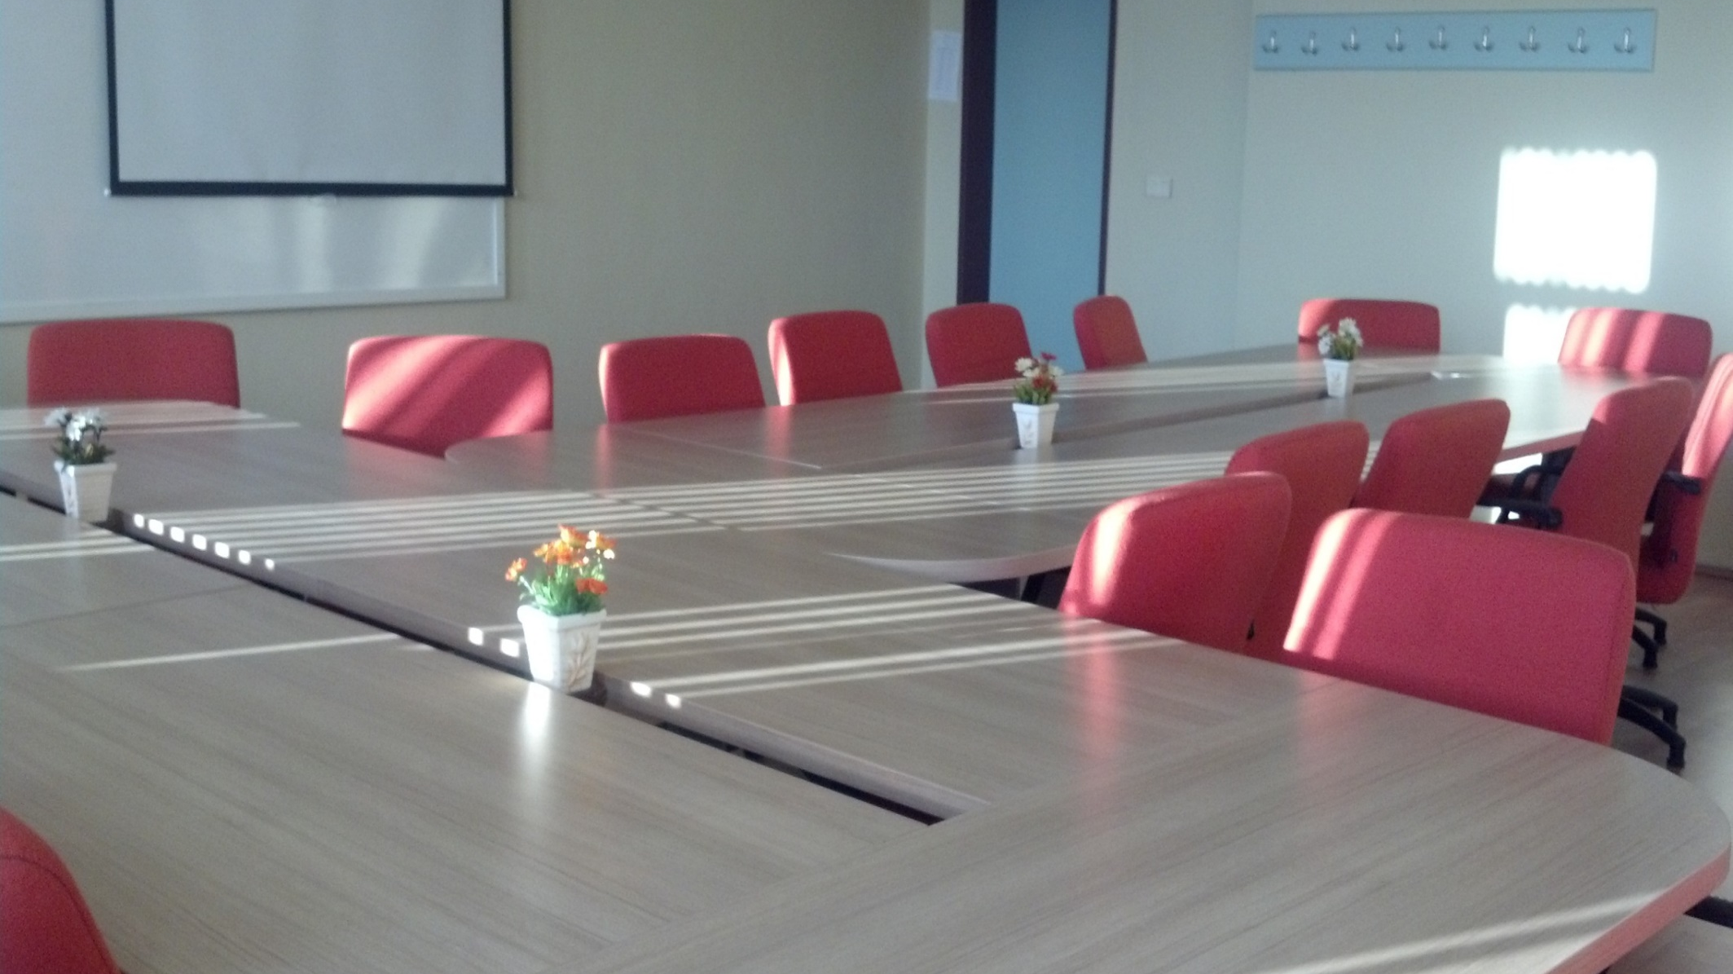
Meeting Room

Slide 24
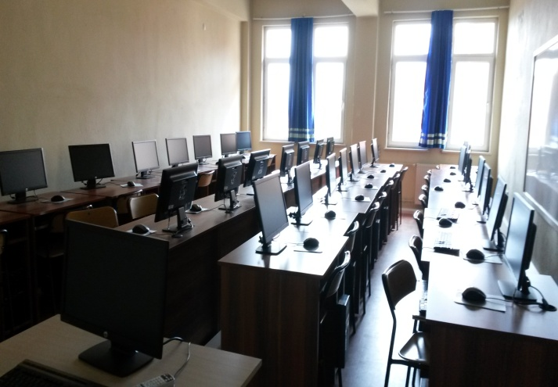
Our Physical Facilities
Our school provides uninterrupted technological support to our students with its computer lab and wireless internet network.

Slide 25
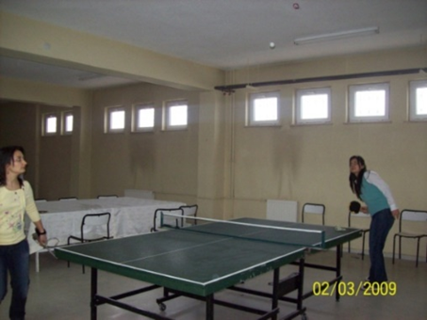
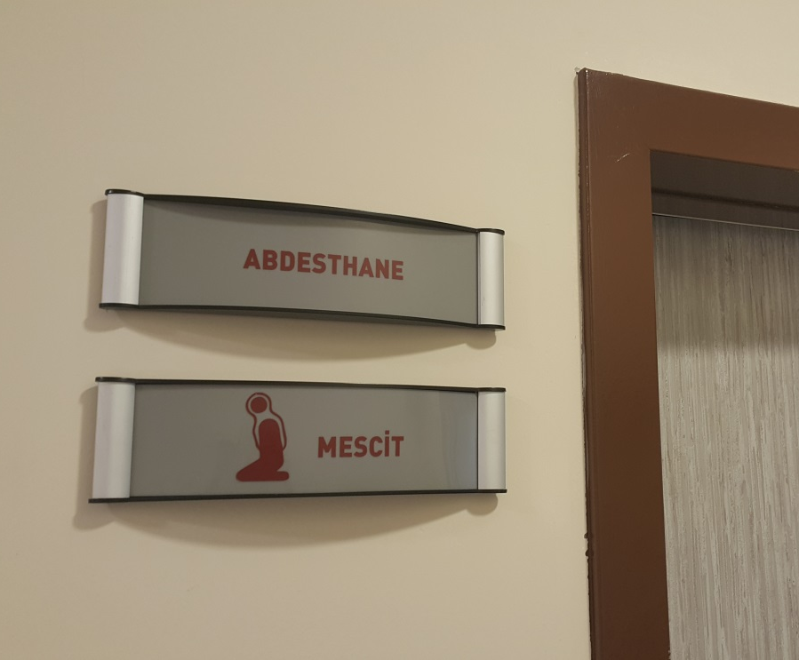
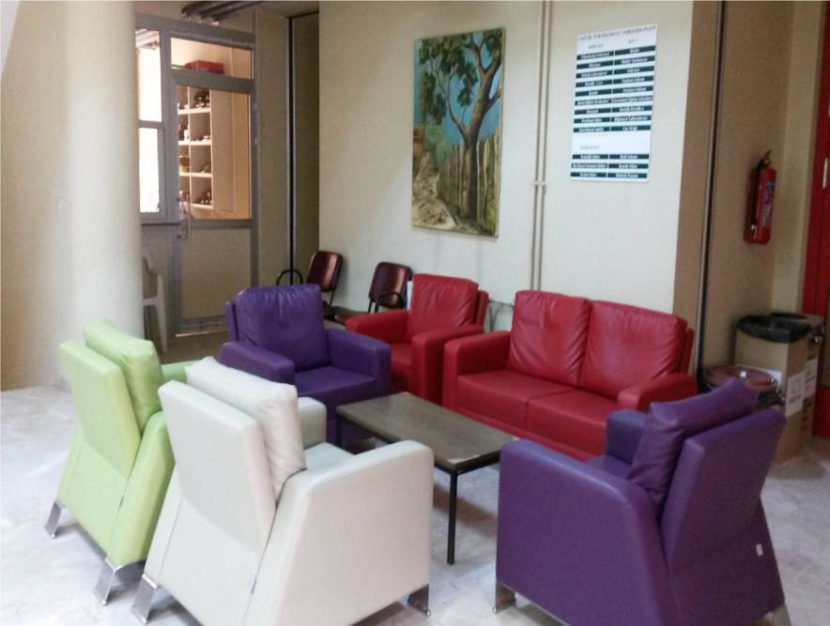
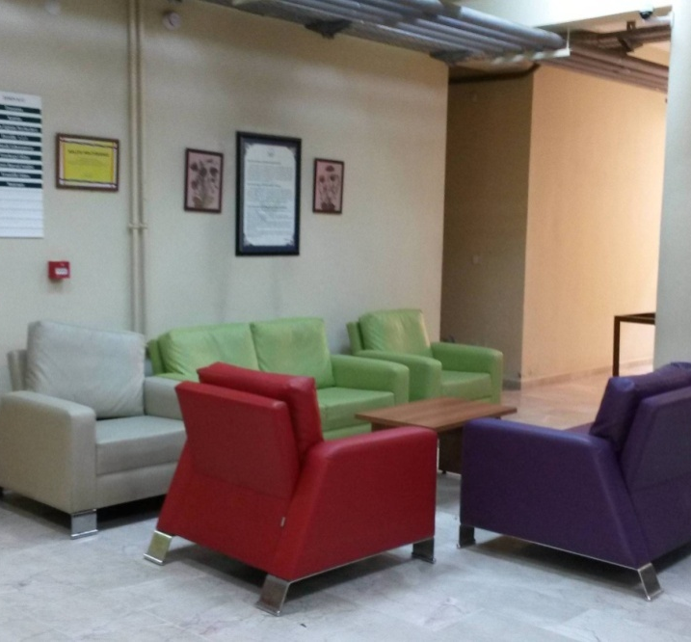
Our Physical Facilities
Rest areas
Hobby and entertainment area (table tennis and chess, television...etc.)
Male and female prayer rooms

Slide 26



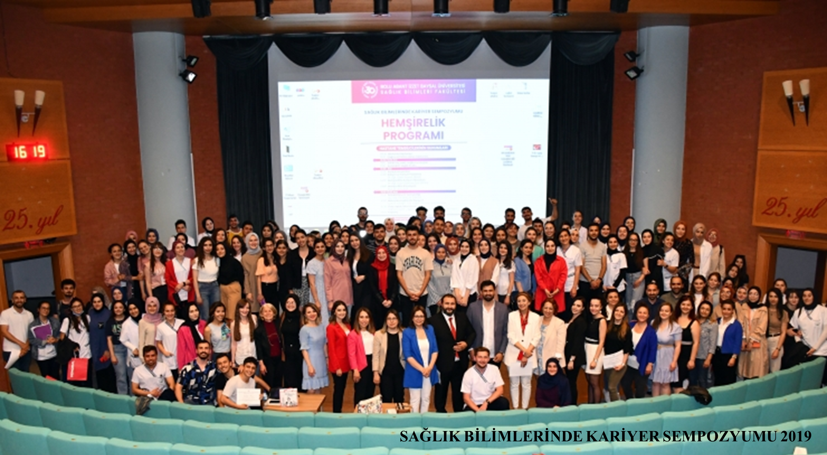
OUR CAREER SYMPOSIUM EVENTS

Slide 27
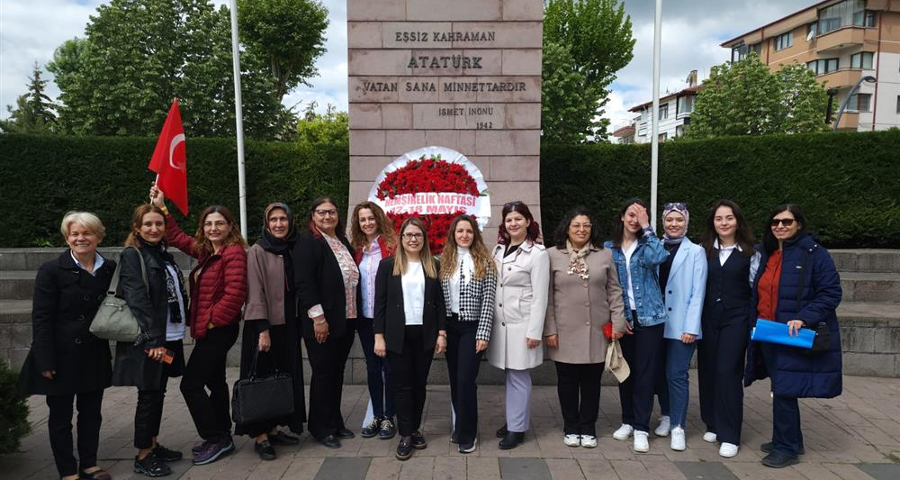

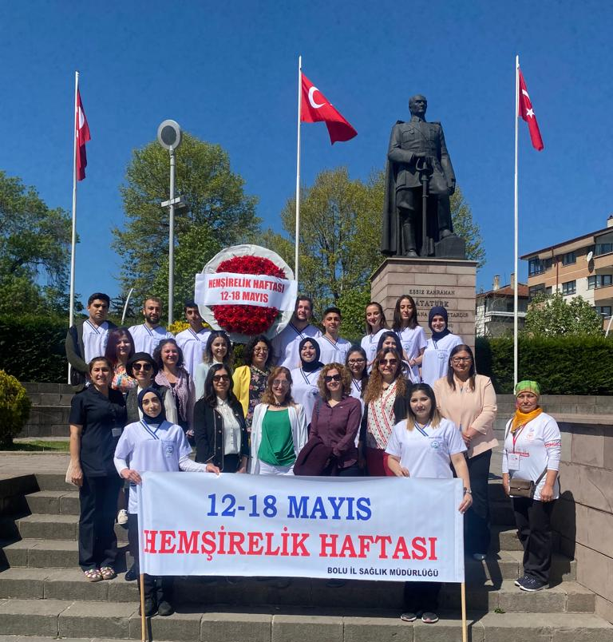
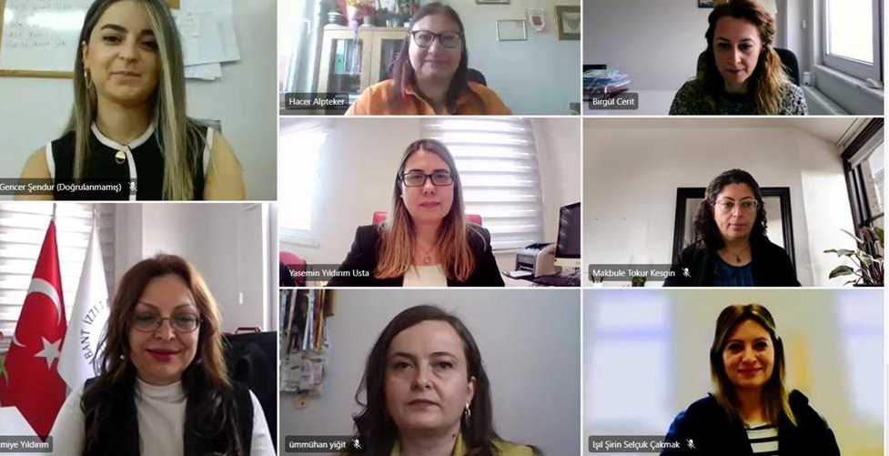
OUR NURSING WEEK EVENTS

Slide 28
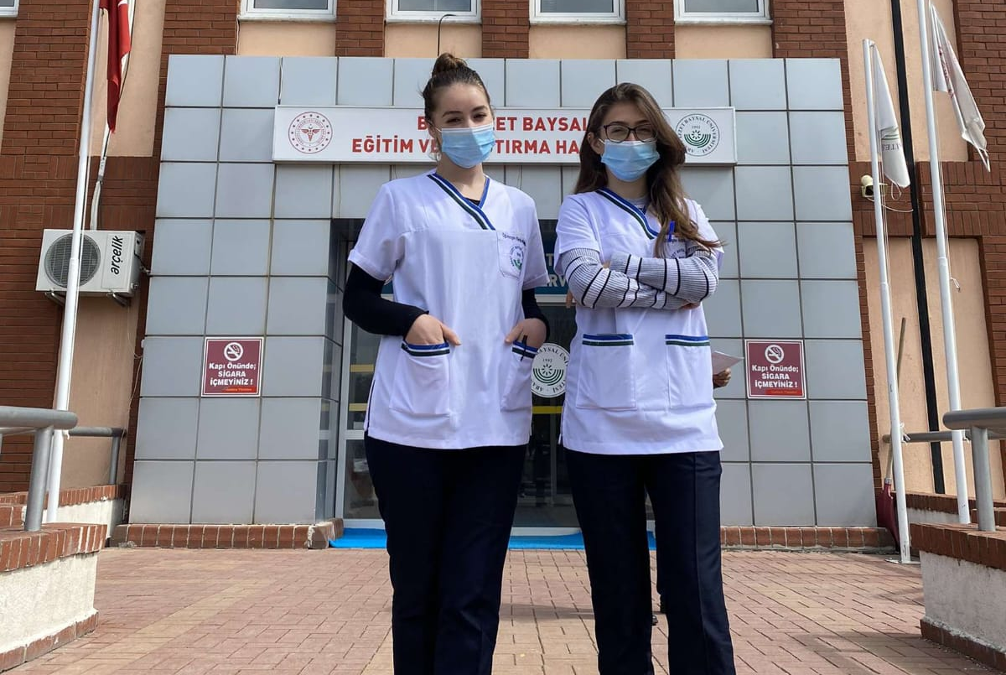
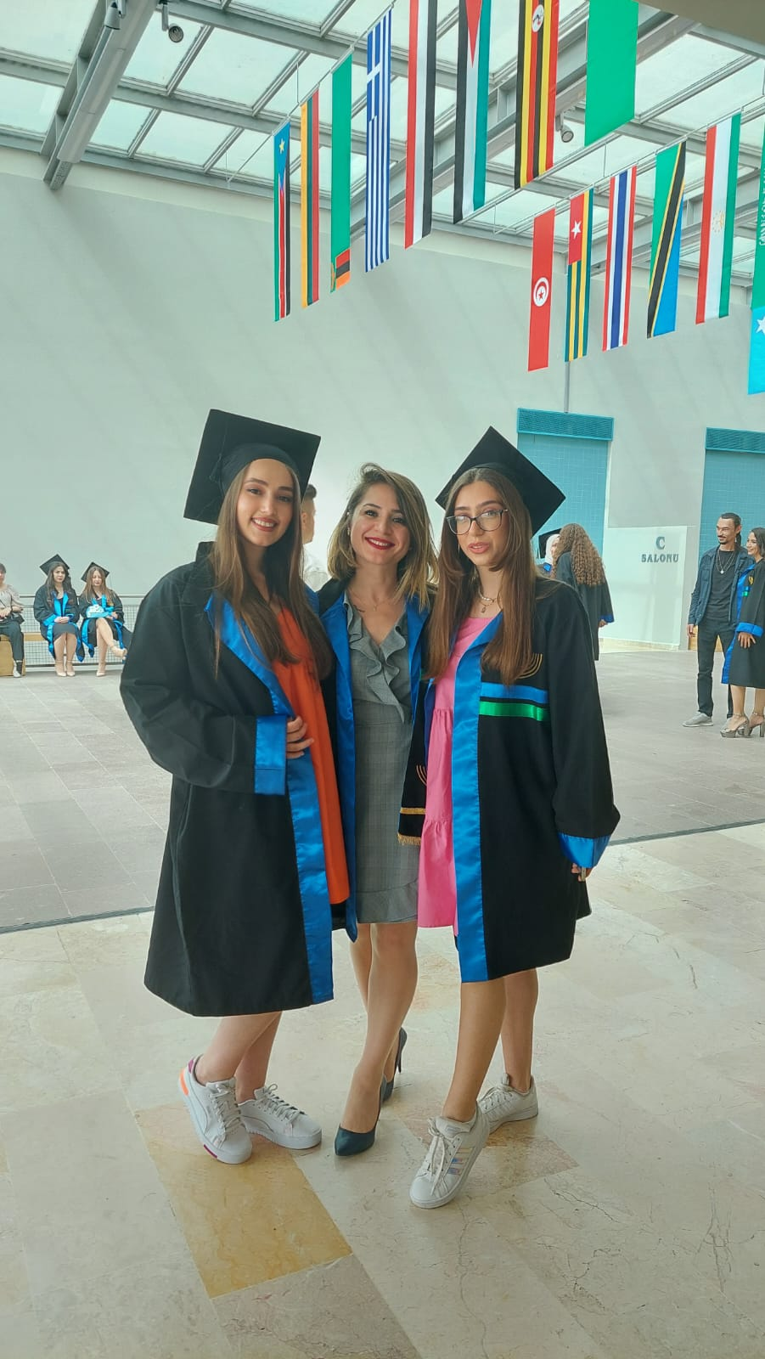
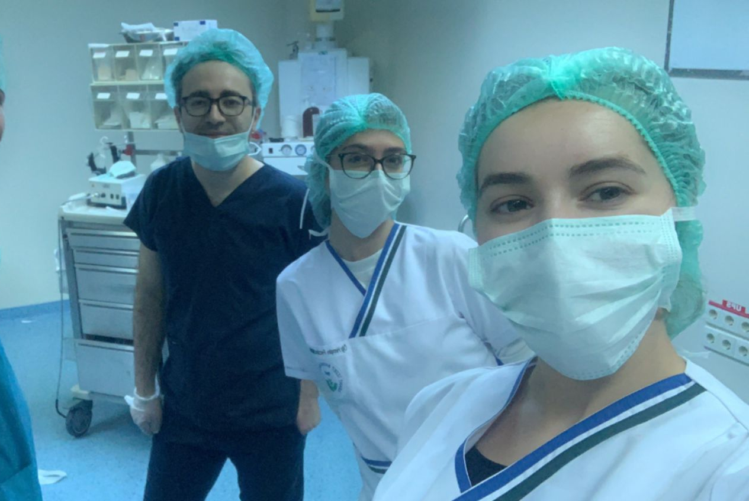

ERASMUS OPPORTUNITIES
Our students have the opportunity to do internship and study in different countries within the scope of the Erasmus program.
Universities we have agreements with;
International Hellenic
UniversityUniversita degli Studi del Molise
International BalkanUniversity
Goce Delcev University

Slide 29
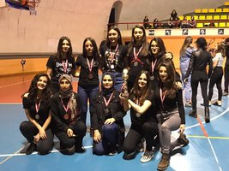
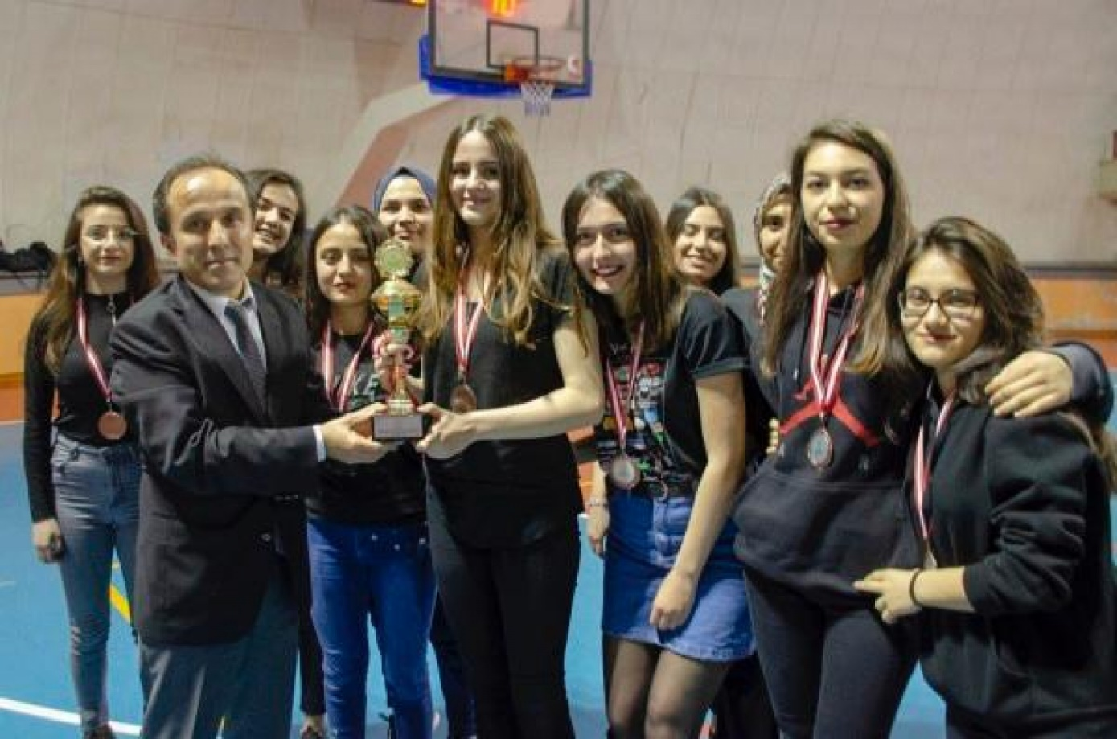
Sportive Activities
Faculty of Health Sciences Girls Basketball Team won the 3rd place cup and medal.

Slide 30


Faculty of Health Sciences Volleyball Teams

Slide 31




From Clinical Applications

Slide 32

From Health Education Applications

Slide 33



Slide 34



35th Izzet Baysal Thanks giving Days Department of Nursing Stand Event

Slide 35



Slide 36





Western Black Sea Career Fair (BATIKAF) 2024 Events

Slide 37


BAIBU First Aid Community
Academic Advisor: Associate. Professor Dr. Ümmühan YİĞİT

Slide 38


BAIBU Health and Innovation Community
Academic Advisor: Associate. Professor Dr. Mehmet KARAKAŞ

Slide 39


BAIBU Nursing and Social Activity Community
Academic Advisor: Associate. Professor Dr. Eylem SUVEREN

Slide 40



Events from our communItIes

Slide 41


EVENTS FROM OUR COMMUNITIES

Slide 42



Graduation
Our Ceremonies

Slide 43



Slide 44


Slide 45



Slide 46




Slide 47

Contact:
Address:
Bolu Abant İzzet Baysal University, Gölköy Campus, Central/Bolu 14280, Turkey
Phone: +90 374 254 10 00
Fax: +90 374 253 45 06
http://www.ibu.edu.tr

